Slide 1
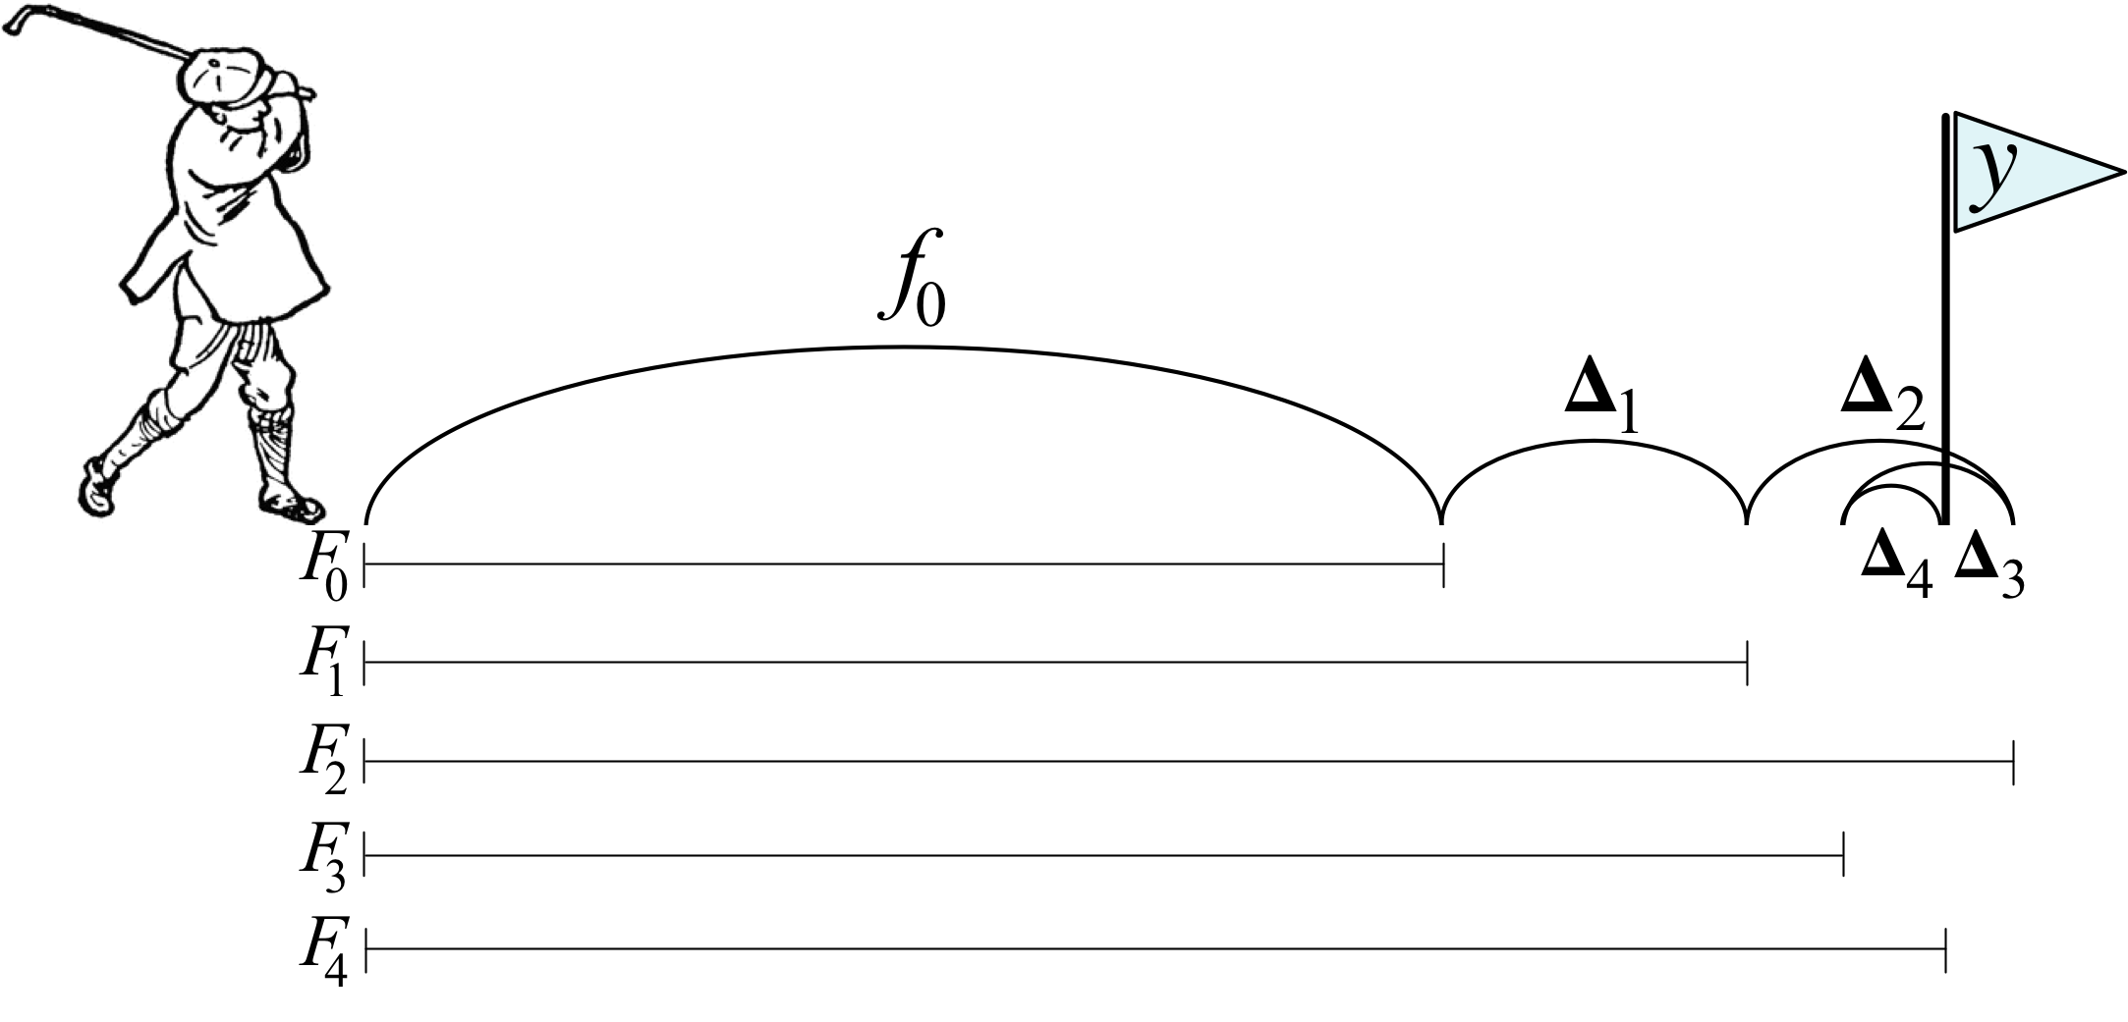
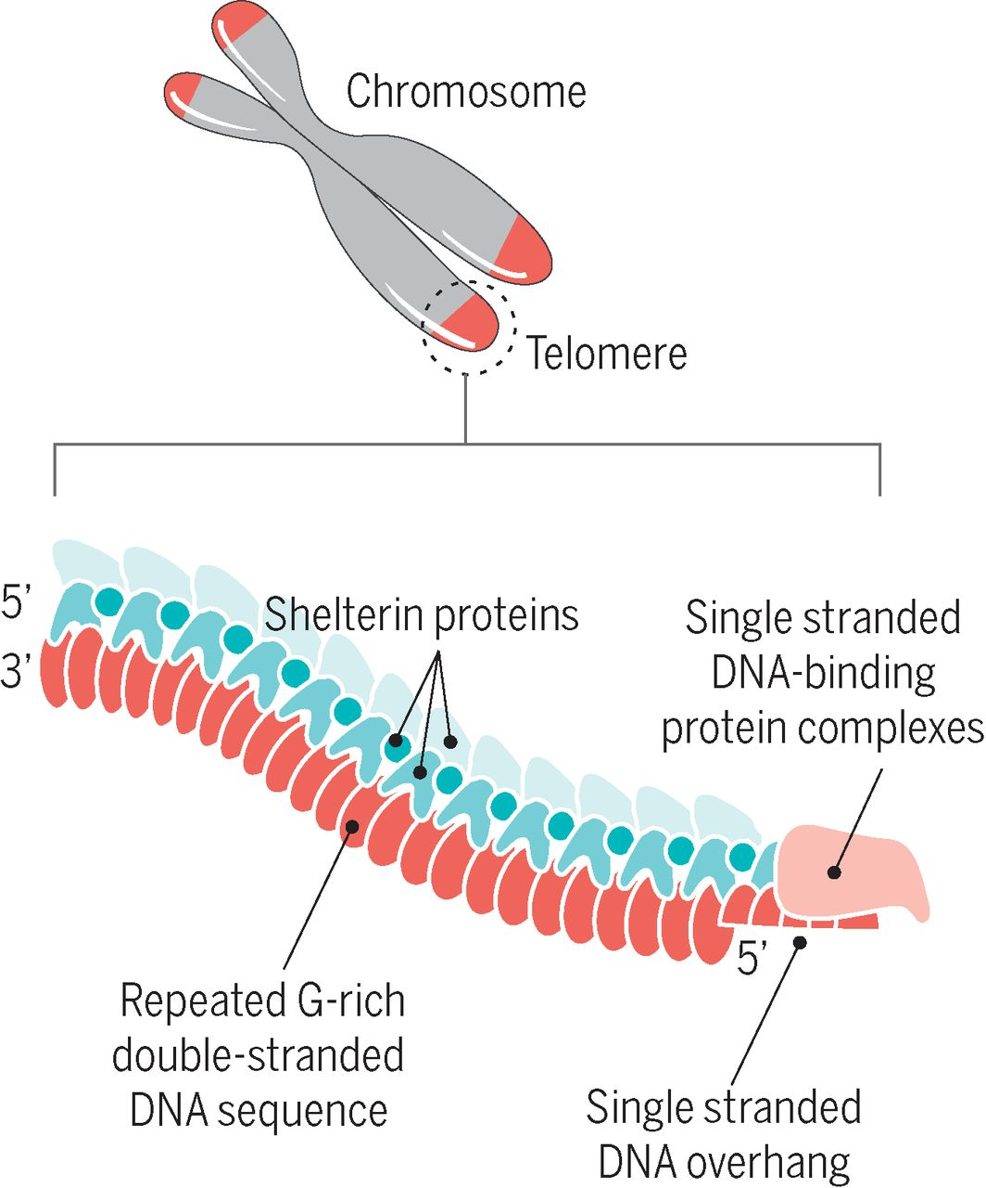
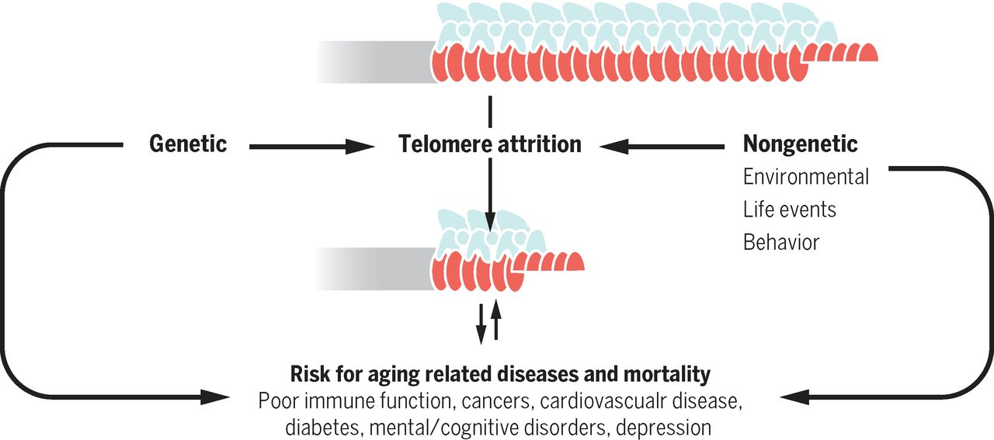
TELOMERE LENGTH AND MACHINE LEARNING
FOR PREDICTING RADIATION LATE EFFECTS
AFTER RADIATION THERAPY
JARED JAMES LUXTON
4th year Ph.D. candidate
PI: Susan M. Bailey
ERHS 770
03/05/20
Notes:
Fig 1. Longitudinal trends in mean telomere length (TeloFISH) during IMRT for patient cohort. Mean telomere length by TeloFISH in cultured T-cells harvested in metaphase (n=50/patient/timepoint) from whole blood of patients (n=15). Each patient’s telomere values were standardized using a pair of BJ1/BJ-hTERT control samples. 1 non irrad: pre-therapy non-irradiated; 2 irrad @ 4 Gy: pre-therapy in vitro irradiated; 3 B: immediate post-therapy; 4 C: late post-therapy. (A) Time-course for all patients. Boxes denote quantiles, horizontal grey lines denote medians. (B) Hierarchical clustering of patients by longitudinal changes in mean telomere length (z-score normalized). (C) Time-course for clustered groups of patients (n=3 and n=11). Center lines denote medians, lighter bands denote confidence intervals. Patient ID 13 not clustered; late post-therapy sample failed to culture. Significance was assessed using a repeated measures ANOVA and post-hoc Tukey’s HSD test.

Slide 2
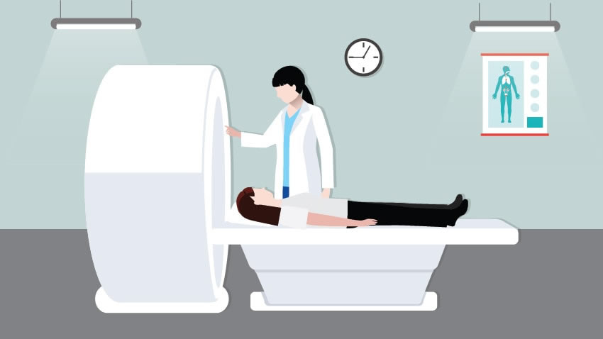

Radiation late effects
Negative outcomes late after radiation therapy:
cardiovascular disease
pulmonary fibrosis
aplastic anemia
secondary cancers
Pediatric patients
Many assays for assessing risk, no standard
Need for new approaches
Notes:
Fig 1. Longitudinal trends in mean telomere length (TeloFISH) during IMRT for patient cohort. Mean telomere length by TeloFISH in cultured T-cells harvested in metaphase (n=50/patient/timepoint) from whole blood of patients (n=15). Each patient’s telomere values were standardized using a pair of BJ1/BJ-hTERT control samples. 1 non irrad: pre-therapy non-irradiated; 2 irrad @ 4 Gy: pre-therapy in vitro irradiated; 3 B: immediate post-therapy; 4 C: late post-therapy. (A) Time-course for all patients. Boxes denote quantiles, horizontal grey lines denote medians. (B) Hierarchical clustering of patients by longitudinal changes in mean telomere length (z-score normalized). (C) Time-course for clustered groups of patients (n=3 and n=11). Center lines denote medians, lighter bands denote confidence intervals. Patient ID 13 not clustered; late post-therapy sample failed to culture. Significance was assessed using a repeated measures ANOVA and post-hoc Tukey’s HSD test.

Slide 3
Telomeres
Adapted from: Elizabeth H. Blackburn et al. Science 2015;350:1193-1198
Notes:
Is Telomeres. Telomeres are the ends of linear chromosomes, often called the guardians of the genome, they solve the end replication, and end protection problems. If a cell has active telomerase, as in germ, stem, and cancer cells, then telomeres are replenished after each cell division. If telomerase is not present, then telomeres will shorten after each cell division. As we’re aging our cells are dividing and so telomeres provide a robust marker of aging. When telomeres become critically short, they can potentiate many diseases associated with aging.. As well many diseases can cause telomere shortening – so telomere length captures this interplay

Slide 4
Telomere length
Telomeres shorten from:
cell division (aging)
oxidative stress
lifestyle factors
environmental exposures
Adapted from: Elizabeth H. Blackburn et al. Science 2015;350:1193-1198
Notes:
Is Telomeres. Telomeres are the ends of linear chromosomes, often called the guardians of the genome, they solve the end replication, and end protection problems. If a cell has active telomerase, as in germ, stem, and cancer cells, then telomeres are replenished after each cell division. If telomerase is not present, then telomeres will shorten after each cell division. As we’re aging our cells are dividing and so telomeres provide a robust marker of aging. When telomeres become critically short, they can potentiate many diseases associated with aging.. As well many diseases can cause telomere shortening – so telomere length captures this interplay

Slide 5
Telomere length influences disease risk
Radiation late effects
cancer (leukemias)
Telomere
length
cardiovascular disease
pulmonary fibrosis
aplastic anemia
Adapted from: Elizabeth H. Blackburn et al. Science 2015;350:1193-1198
Notes:
Telomeres can shorten in response to environmental exposures, as well as lifestyle choices; so telomeres capture aging, age-related diseases, and environmental exposures.. This would include the unique stressors of spaceflight

Slide 6
Hypothesis:
patient’s pre-therapy telomere data will
predict long-term post-therapy telomeric outcomes
Possible to predict?
Patient’s pre-therapy
telomere length
Response to radiation therapy
Post-therapy telomeric outcomes: modified risks
Adapted from: Elizabeth H. Blackburn et al. Science 2015;350:1193-1198
Notes:
Telomeres can shorten in response to environmental exposures, as well as lifestyle choices; so telomeres capture aging, age-related diseases, and environmental exposures.. This would include the unique stressors of spaceflight

Slide 7
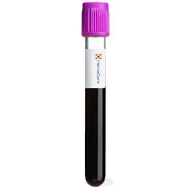
Study design
Longitudinal analysis of 15 prostate cancer patients pre/post/late-post Intensity Modulated Radiation Therapy
Pre-therapy non-irradiated
Pre-therapy
Pre-therapy irradiated in vitro
Whole blood
Immediately post therapy
*proxy for in vivo response
4 Gy
(Cs137)
Late post therapy
Notes:
We have two streams for our sample analyses.. First from whole blood we extract peripheral blood mononucleocytes (PBMCS), a radiation sensitive cell type, and subject these to telomere length analyses by qPCR and telomerase activity analysis by TRAP; I am focusing on telomere length today. We also stimulate and harvest T-cells and subject these to telomere FISH for analyzing individual telomere legnths and directional genomic hybridization for chromosome aberrations; these are cytogenetics, fluorescence microscopy based techniques. All of the data is passed through python scripts Ive made which assist with data compiling and analyses

Slide 8
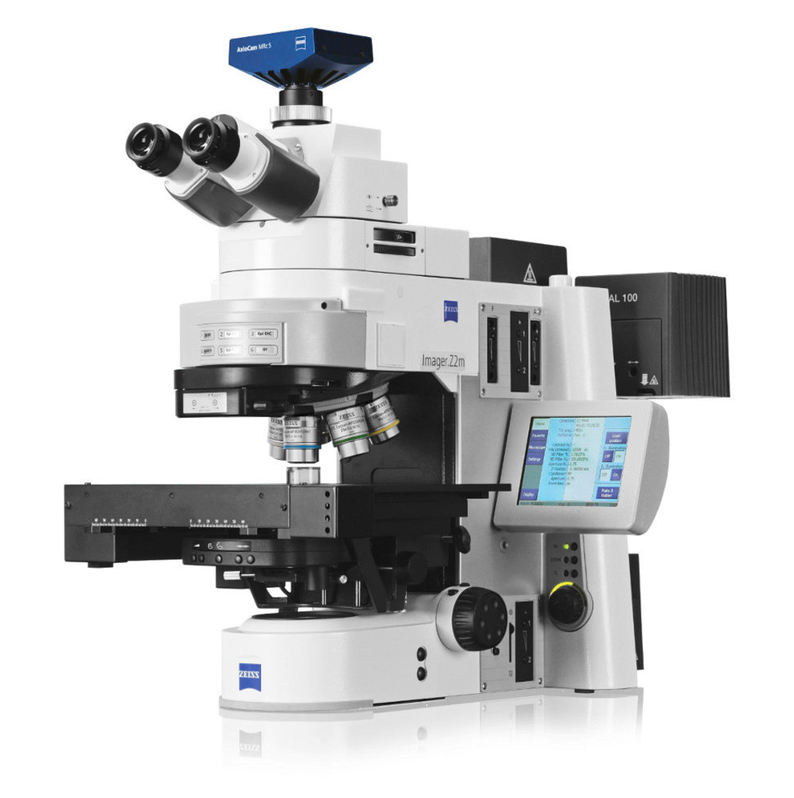
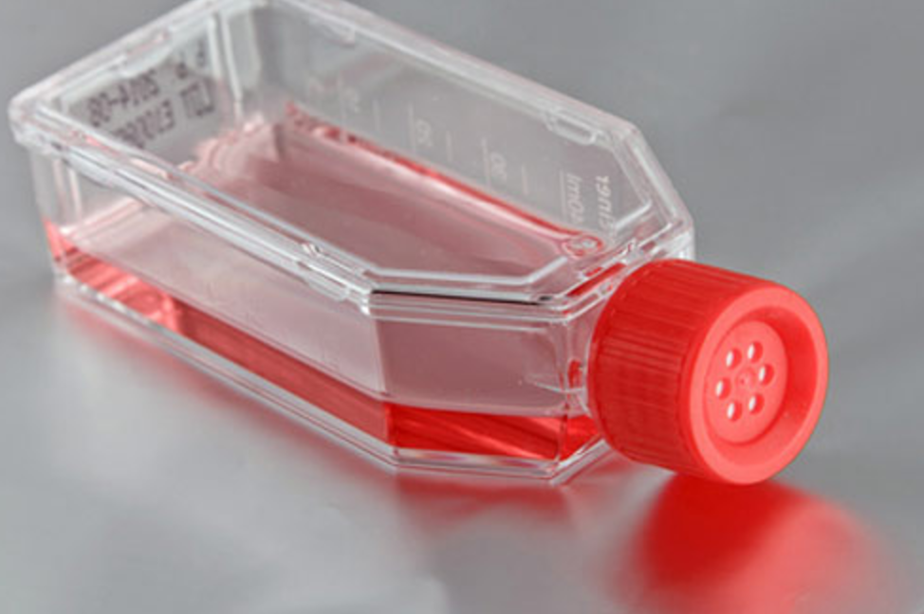
Study design
Whole blood
telomere FISH (TeloFISH)
(individual telomere lengths)
raw
data
T-cells
Python scripts (jupyter notebooks):
automated data compiling
analyses (statistics, visualizations)
machine learning
Notes:
We have two streams for our sample analyses.. First from whole blood we extract peripheral blood mononucleocytes (PBMCS), a radiation sensitive cell type, and subject these to telomere length analyses by qPCR and telomerase activity analysis by TRAP; I am focusing on telomere length today. We also stimulate and harvest T-cells and subject these to telomere FISH for analyzing individual telomere legnths and directional genomic hybridization for chromosome aberrations; these are cytogenetics, fluorescence microscopy based techniques. All of the data is passed through python scripts Ive made which assist with data compiling and analyses

Slide 9
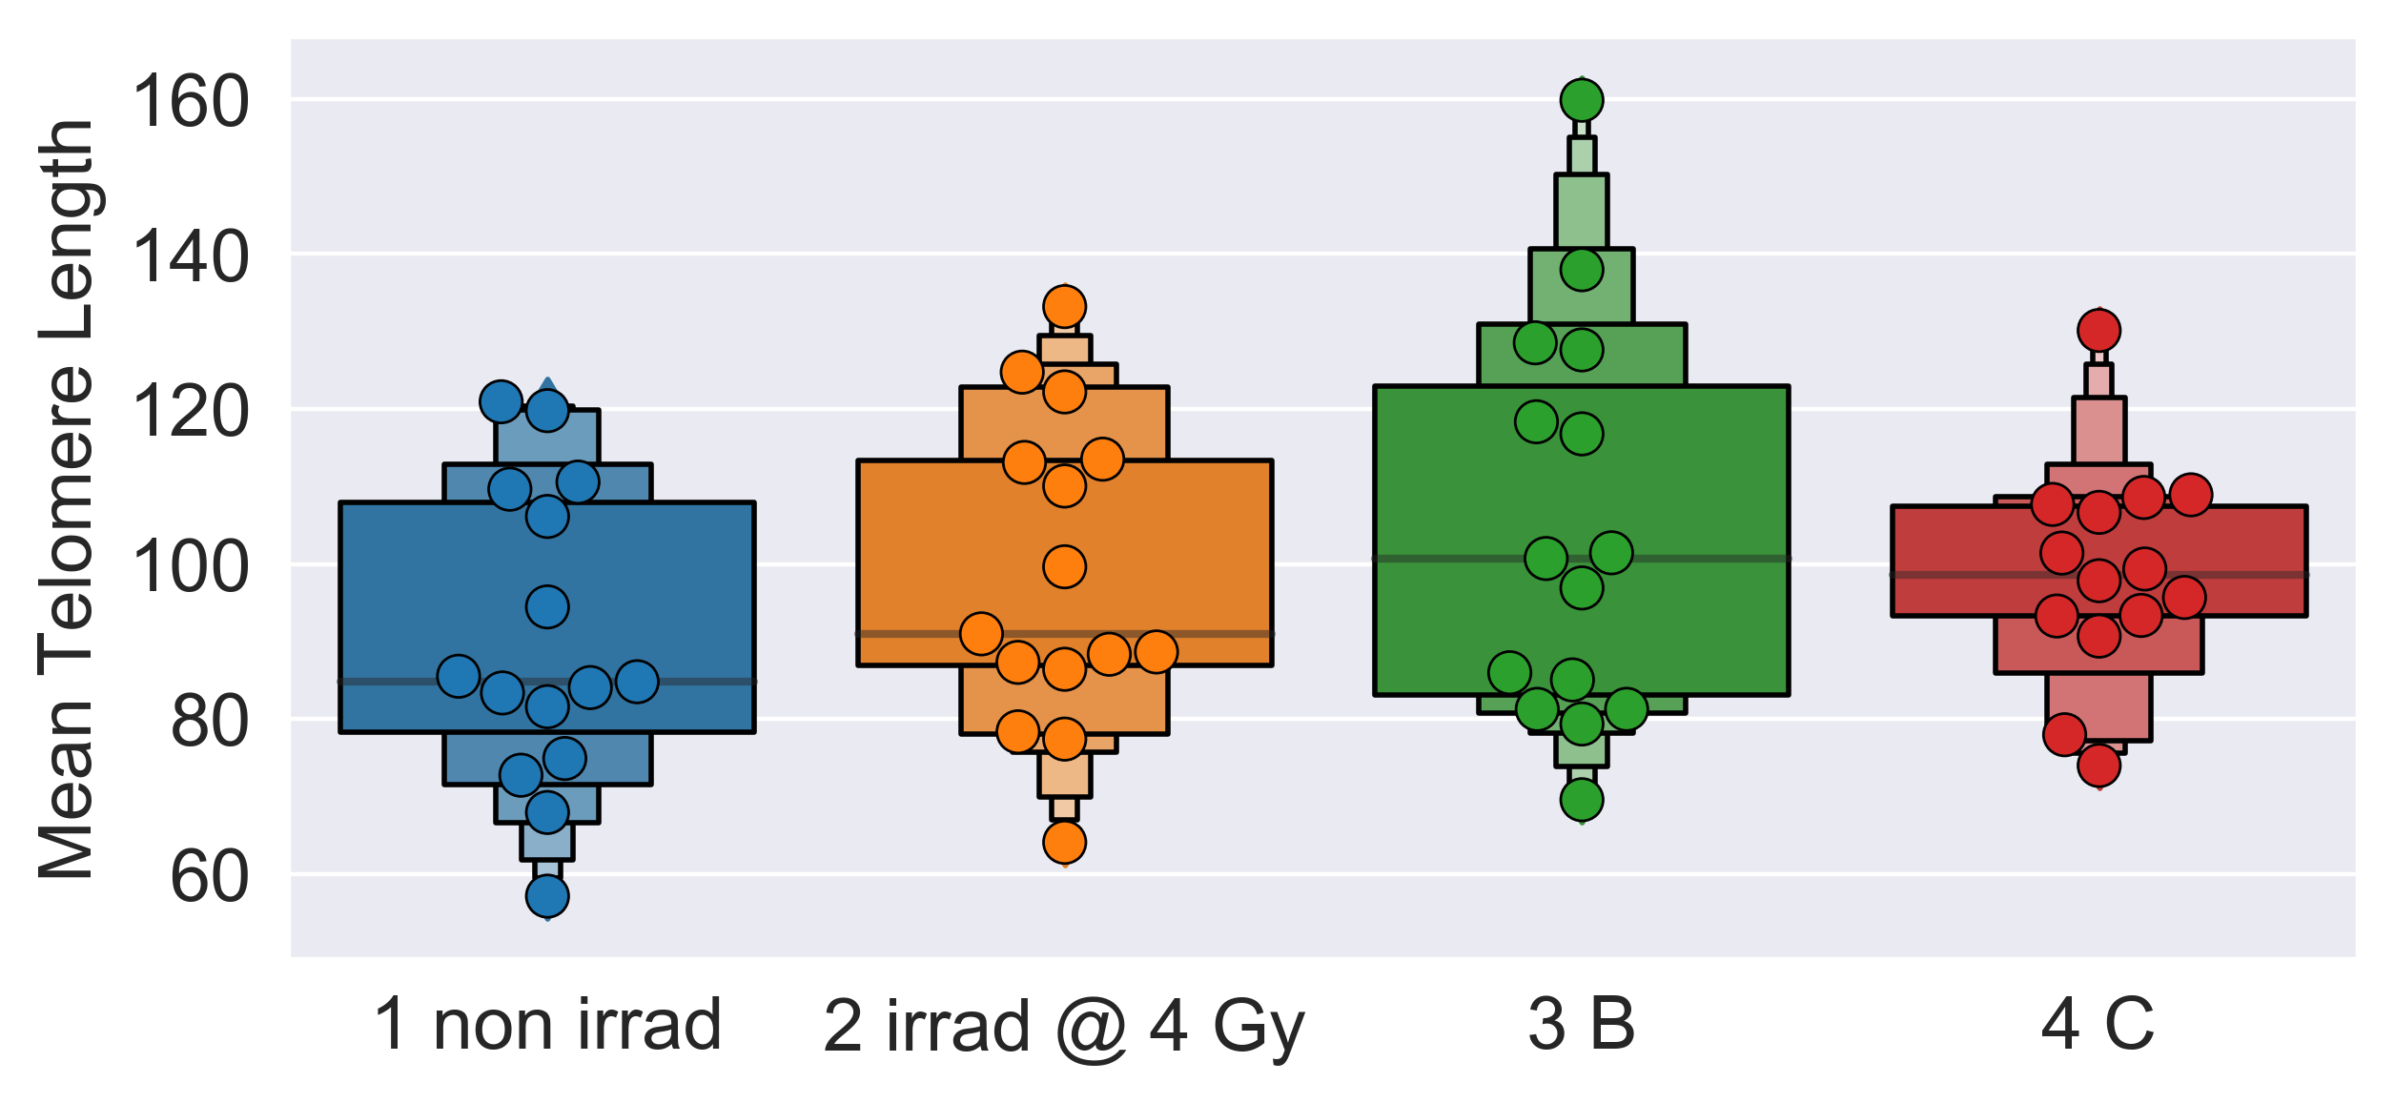
Overall, mean telomere length increased post-therapy (3 B, 4 C)

Slide 10
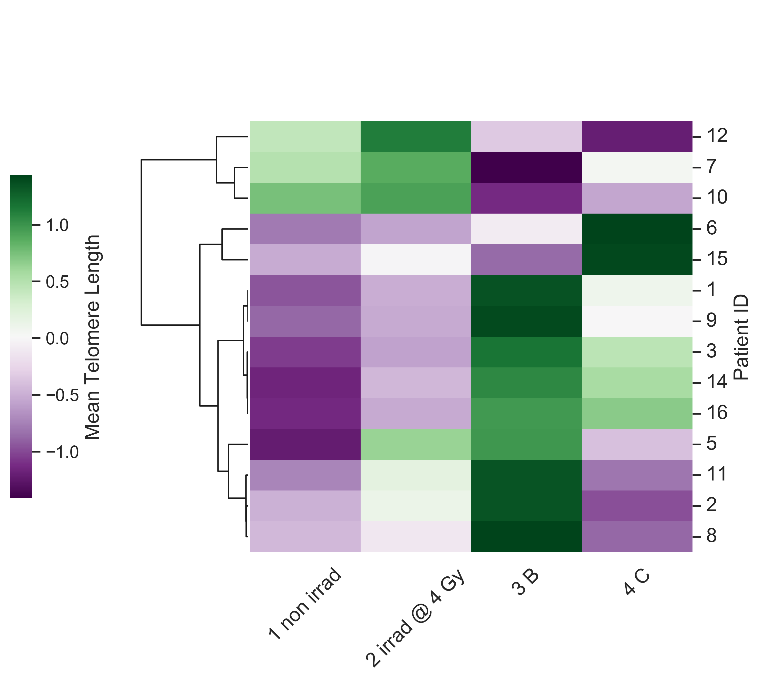
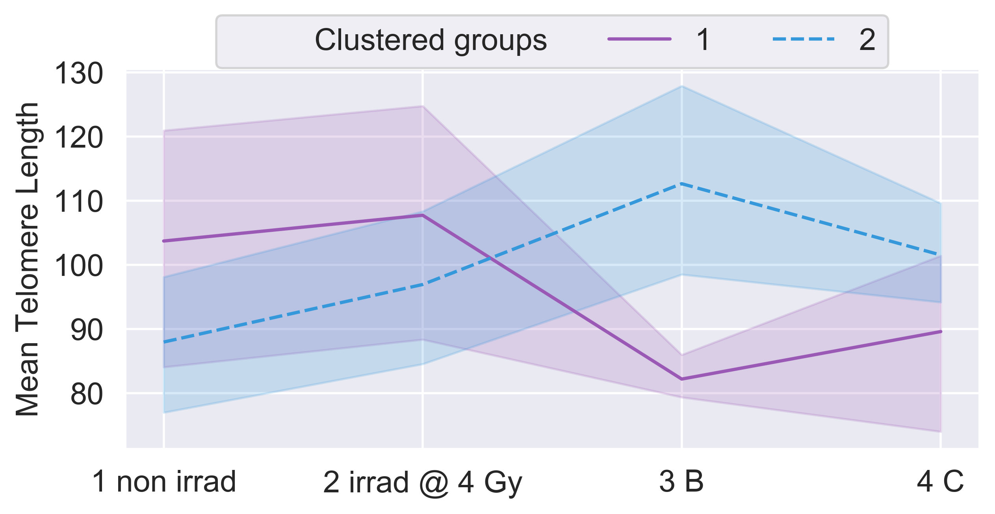
Clustering by mean telomere length reveals
sub-groups of patient responses
Notes:
Fig 3. Longitudinal trends in numbers of short and long telomeres (TeloFISH) during IMRT for patient cohort. Numbers of short and long telomeres feature engineered from individual telomere length distributions per patient. 1 non irrad: pre-therapy non-irradiated; 2 irrad @ 4 Gy: pre-therapy in vitro irradiated; 3 B: immediate post-therapy; 4 C: late post-therapy. Shortest (yellow), mid-length (blue), and longest (red) telomeres were feature engineered per patient (n=15) (see Materials and Methods). (A) Counts of short, medium, and long telomeres, 4600 individual telomeres per patient (n=15) per time point. Significance was assessed for counts of short and long telomere using a square-root transformation and a repeated measures ANOVA with post-hoc Tukey’s HSD test. Hierarchical clustering of patients by longitudinal changes in numbers of short telomeres (B) and long telomeres (D) (z-score normalized). Time-courses of patient groups (n=3 and n=11) clustered by numbers of short (C) and long (E) telomeres. Patient ID 13 not clustered; late post-therapy sample failed to culture. Center lines denote medians and lighter bands denote confidence intervals.

Slide 11
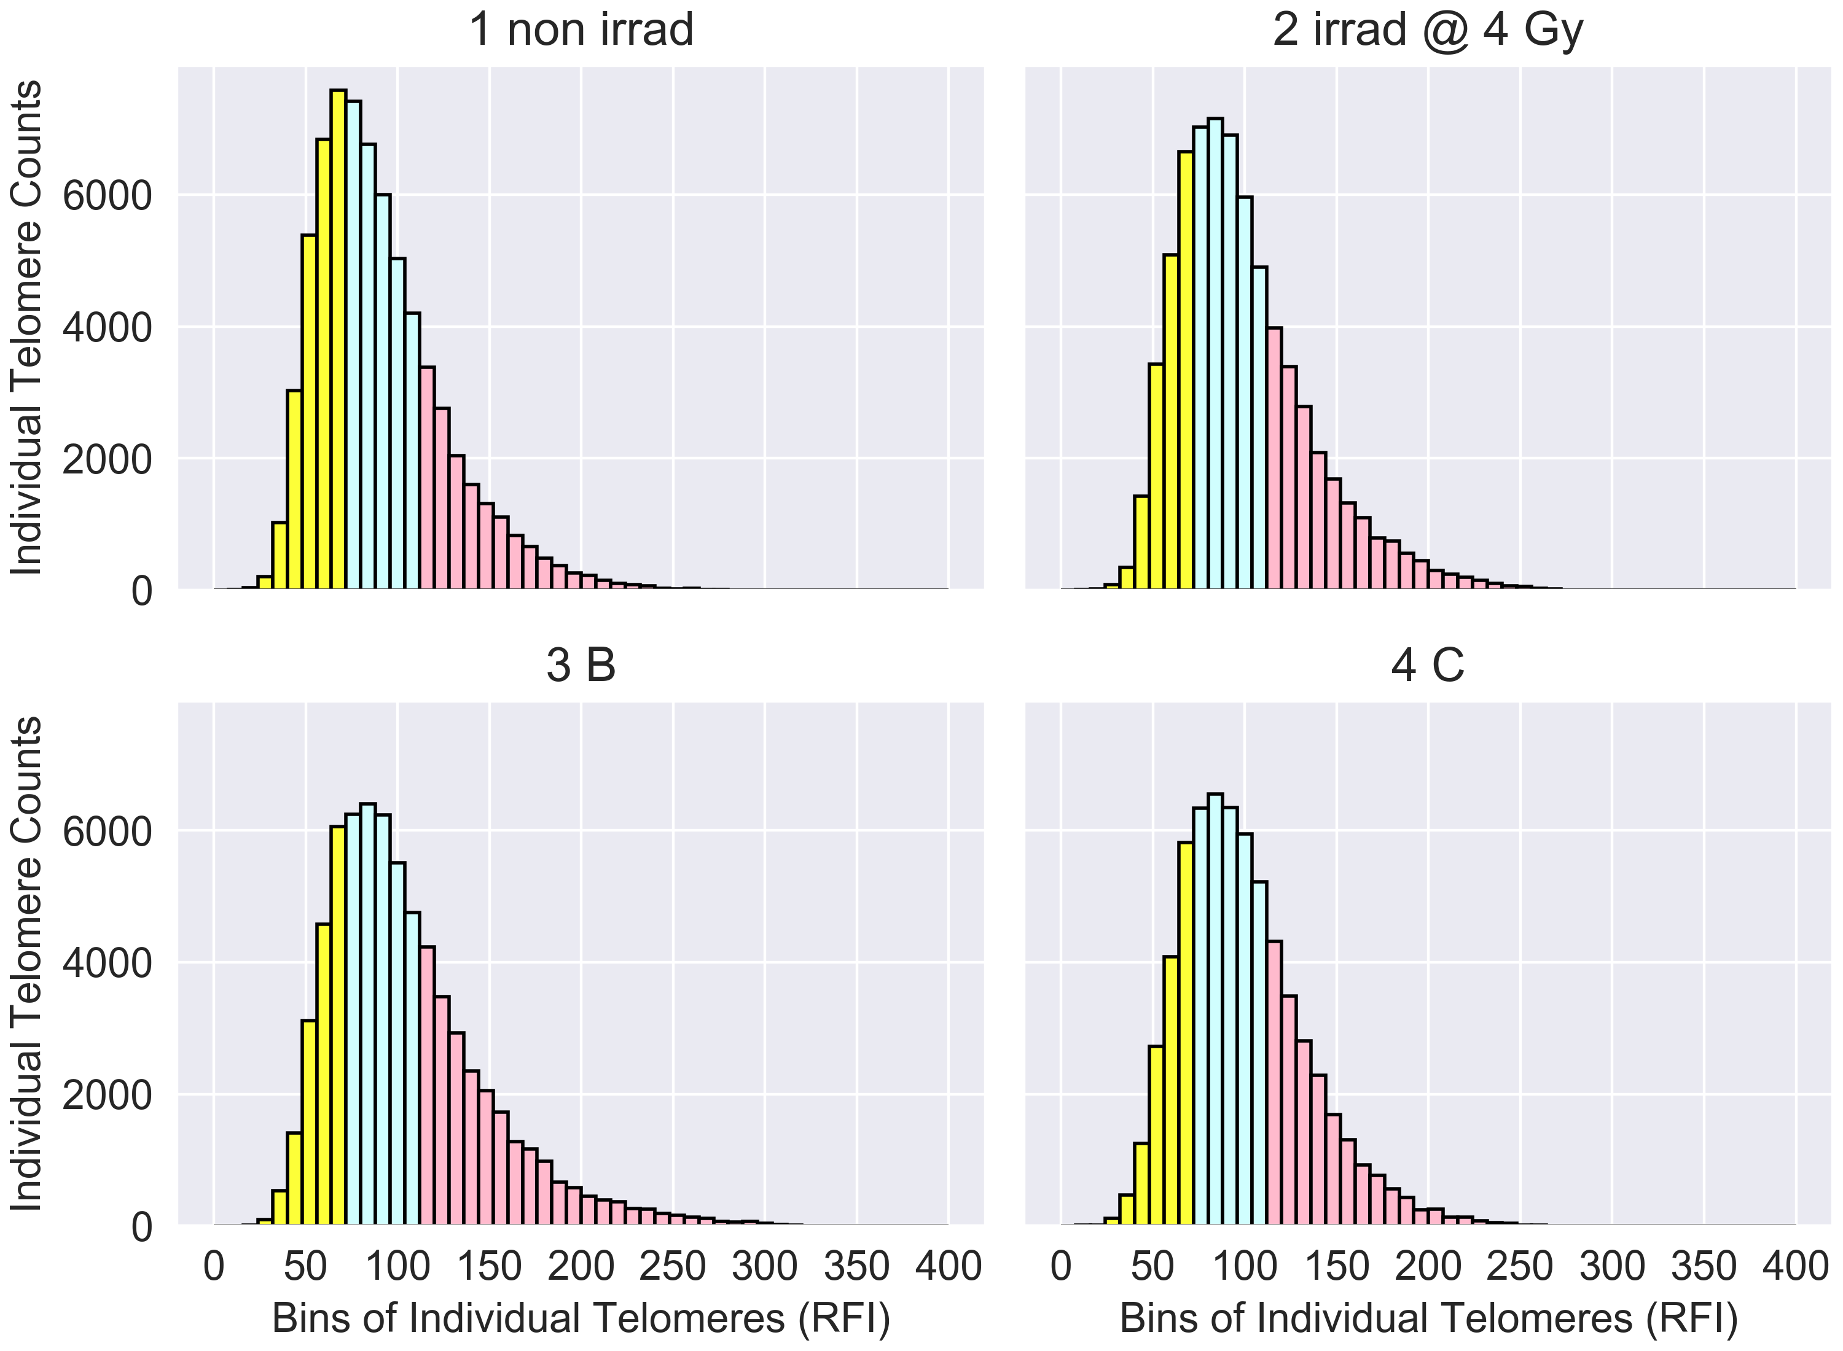
Overall cohort: number of long telomeres increased post-therapy (3 B, 4 C)
Notes:
Fig 2. Longitudinal trends for individual telomere length distributions (TeloFISH) for patient cohort during IMRT. Individual telomere length distributions of patients (n=15) by TeloFISH (50 metaphases per patient/time point). 1 non irrad: pre-therapy non-irradiated; 2 irrad @ 4 Gy: pre-therapy in vitro irradiated; 3 B: immediate post-therapy; 4 C: late post-therapy. Individual telomeres from the pre-therapy non-irradiated time point were split into quartiles, designating telomeres in bottom 25% in yellow, the middle 50% in blue, and top 25% in red. Quartile cut-off values, established by the distribution of the pre-therapy non-irradiated time point, were applied to subsequent time points to feature engineer the relative shortest (yellow), mid-length (blue), and longest (red) individual telomeres per time point. (A) Aggregate of individual telomeres for all patients per time point. (B) Aggregate of individual telomeres for patients in mean telomere length clustered group 1 (n=3) and (C) group 2. (n=11)

Slide 12
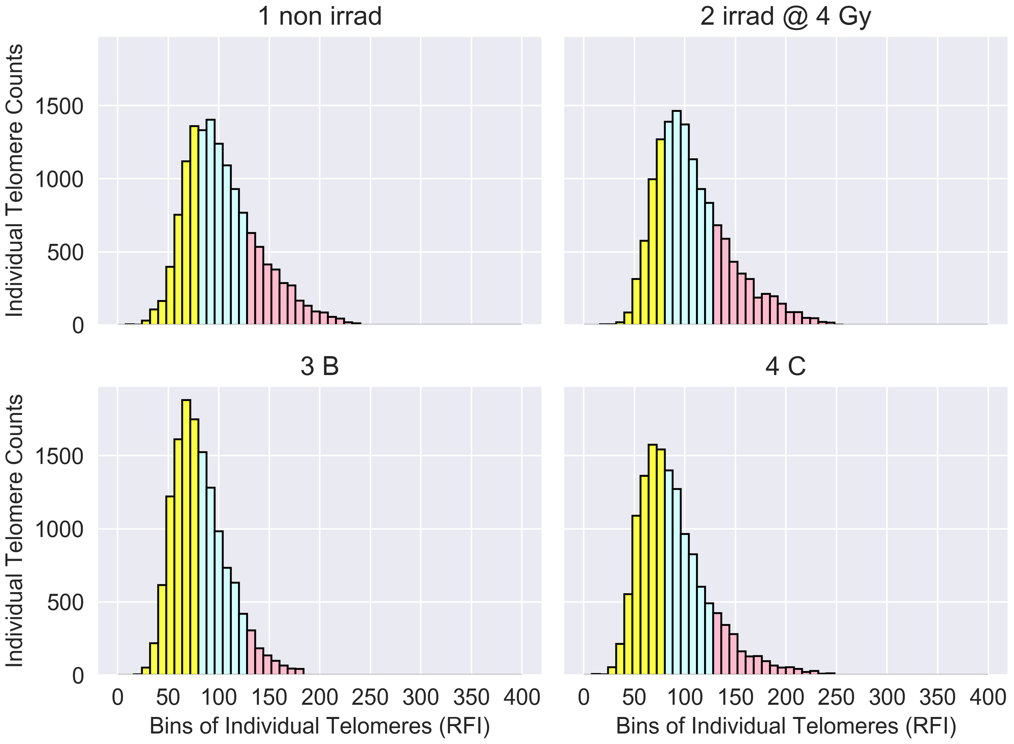
Cluster group 1: increased numbers of short telomeres post-therapy
Notes:
Fig 2. Longitudinal trends for individual telomere length distributions (TeloFISH) for patient cohort during IMRT. Individual telomere length distributions of patients (n=15) by TeloFISH (50 metaphases per patient/time point). 1 non irrad: pre-therapy non-irradiated; 2 irrad @ 4 Gy: pre-therapy in vitro irradiated; 3 B: immediate post-therapy; 4 C: late post-therapy. Individual telomeres from the pre-therapy non-irradiated time point were split into quartiles, designating telomeres in bottom 25% in yellow, the middle 50% in blue, and top 25% in red. Quartile cut-off values, established by the distribution of the pre-therapy non-irradiated time point, were applied to subsequent time points to feature engineer the relative shortest (yellow), mid-length (blue), and longest (red) individual telomeres per time point. (A) Aggregate of individual telomeres for all patients per time point. (B) Aggregate of individual telomeres for patients in mean telomere length clustered group 1 (n=3) and (C) group 2. (n=11)

Slide 13
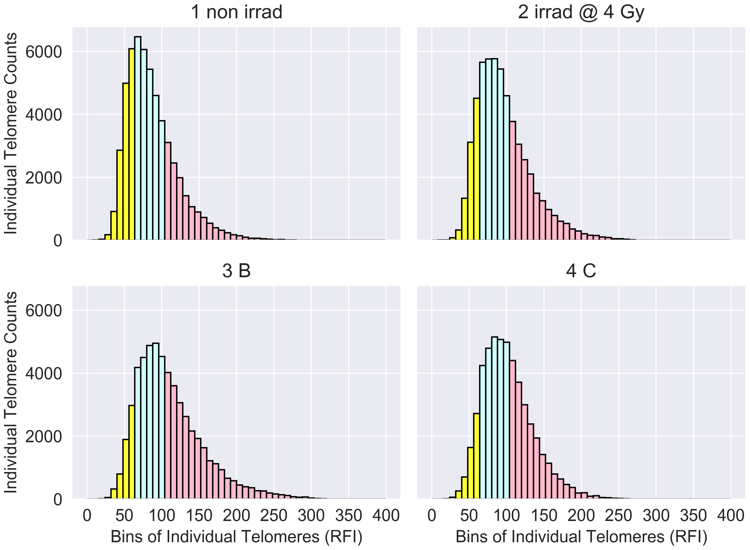
Cluster group 2: increased numbers of long telomeres post-therapy
Notes:
Fig 2. Longitudinal trends for individual telomere length distributions (TeloFISH) for patient cohort during IMRT. Individual telomere length distributions of patients (n=15) by TeloFISH (50 metaphases per patient/time point). 1 non irrad: pre-therapy non-irradiated; 2 irrad @ 4 Gy: pre-therapy in vitro irradiated; 3 B: immediate post-therapy; 4 C: late post-therapy. Individual telomeres from the pre-therapy non-irradiated time point were split into quartiles, designating telomeres in bottom 25% in yellow, the middle 50% in blue, and top 25% in red. Quartile cut-off values, established by the distribution of the pre-therapy non-irradiated time point, were applied to subsequent time points to feature engineer the relative shortest (yellow), mid-length (blue), and longest (red) individual telomeres per time point. (A) Aggregate of individual telomeres for all patients per time point. (B) Aggregate of individual telomeres for patients in mean telomere length clustered group 1 (n=3) and (C) group 2. (n=11)

Slide 14
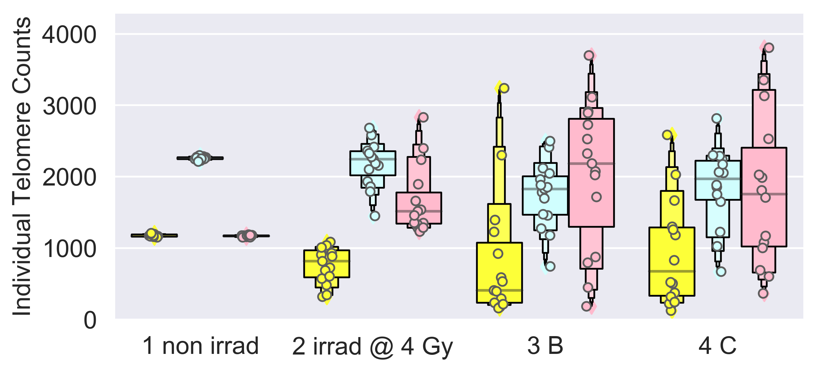
Numbers of short (yellow) & long (red) telomeres per patient

Slide 15
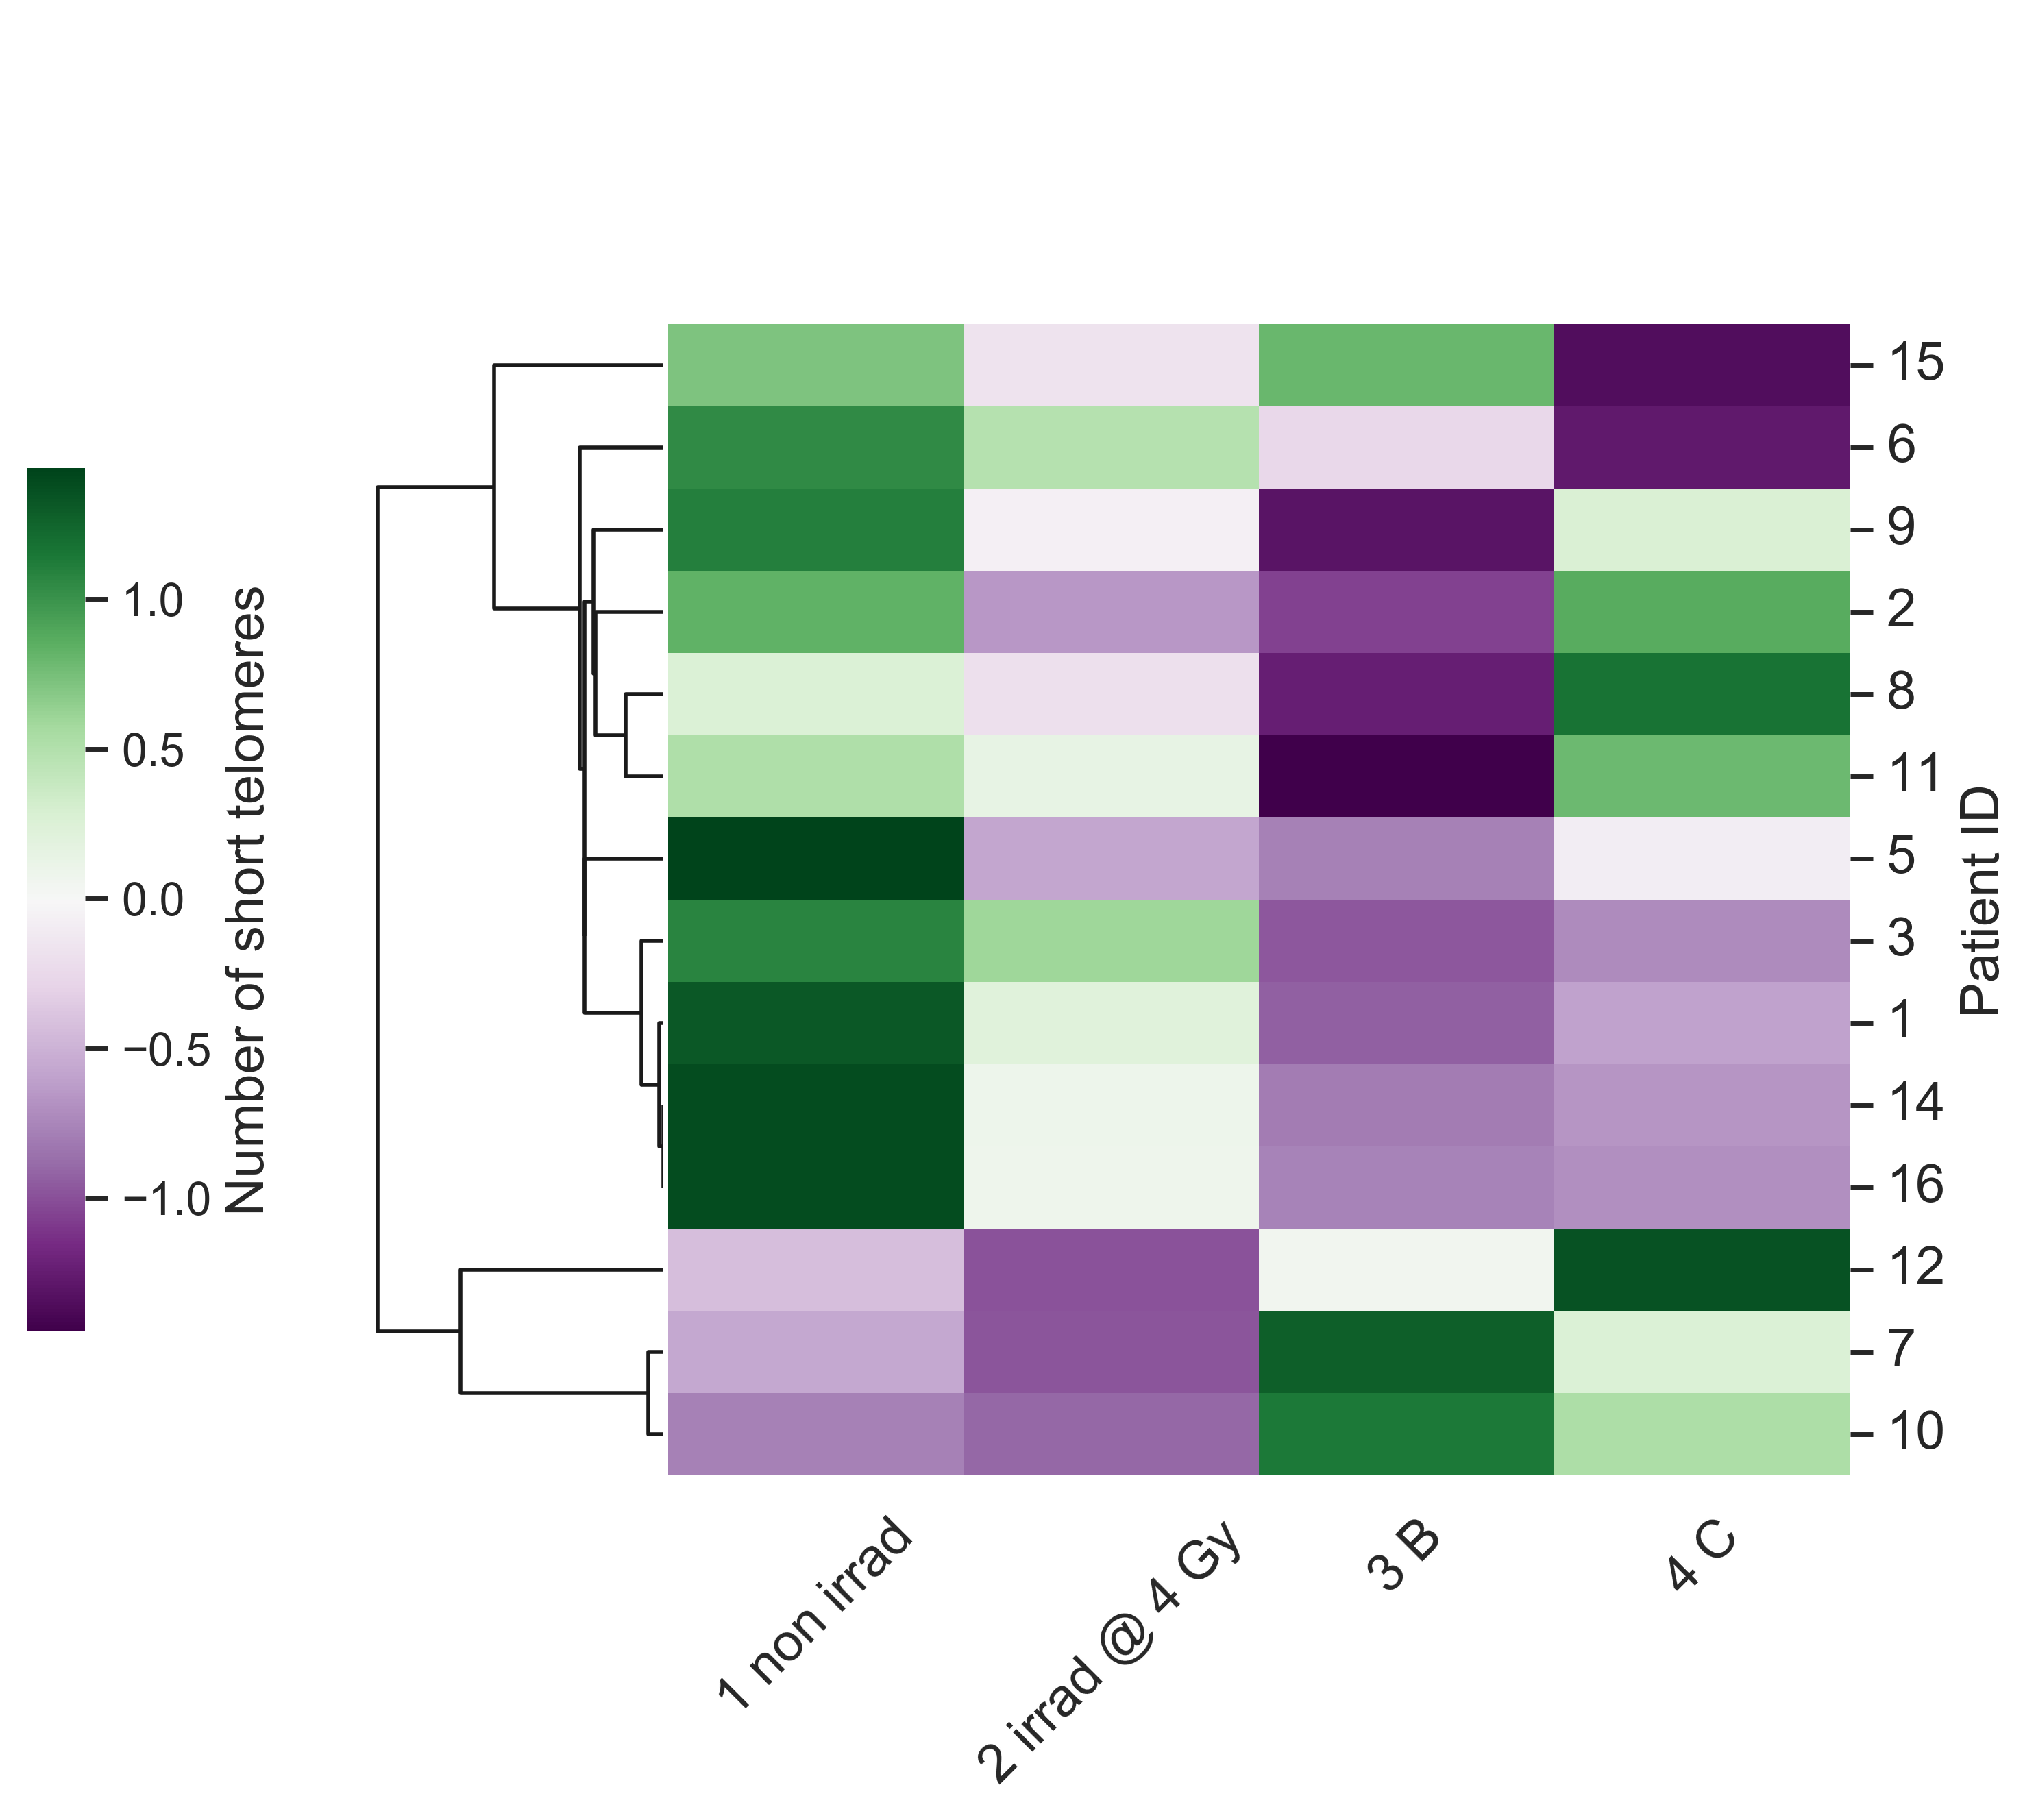
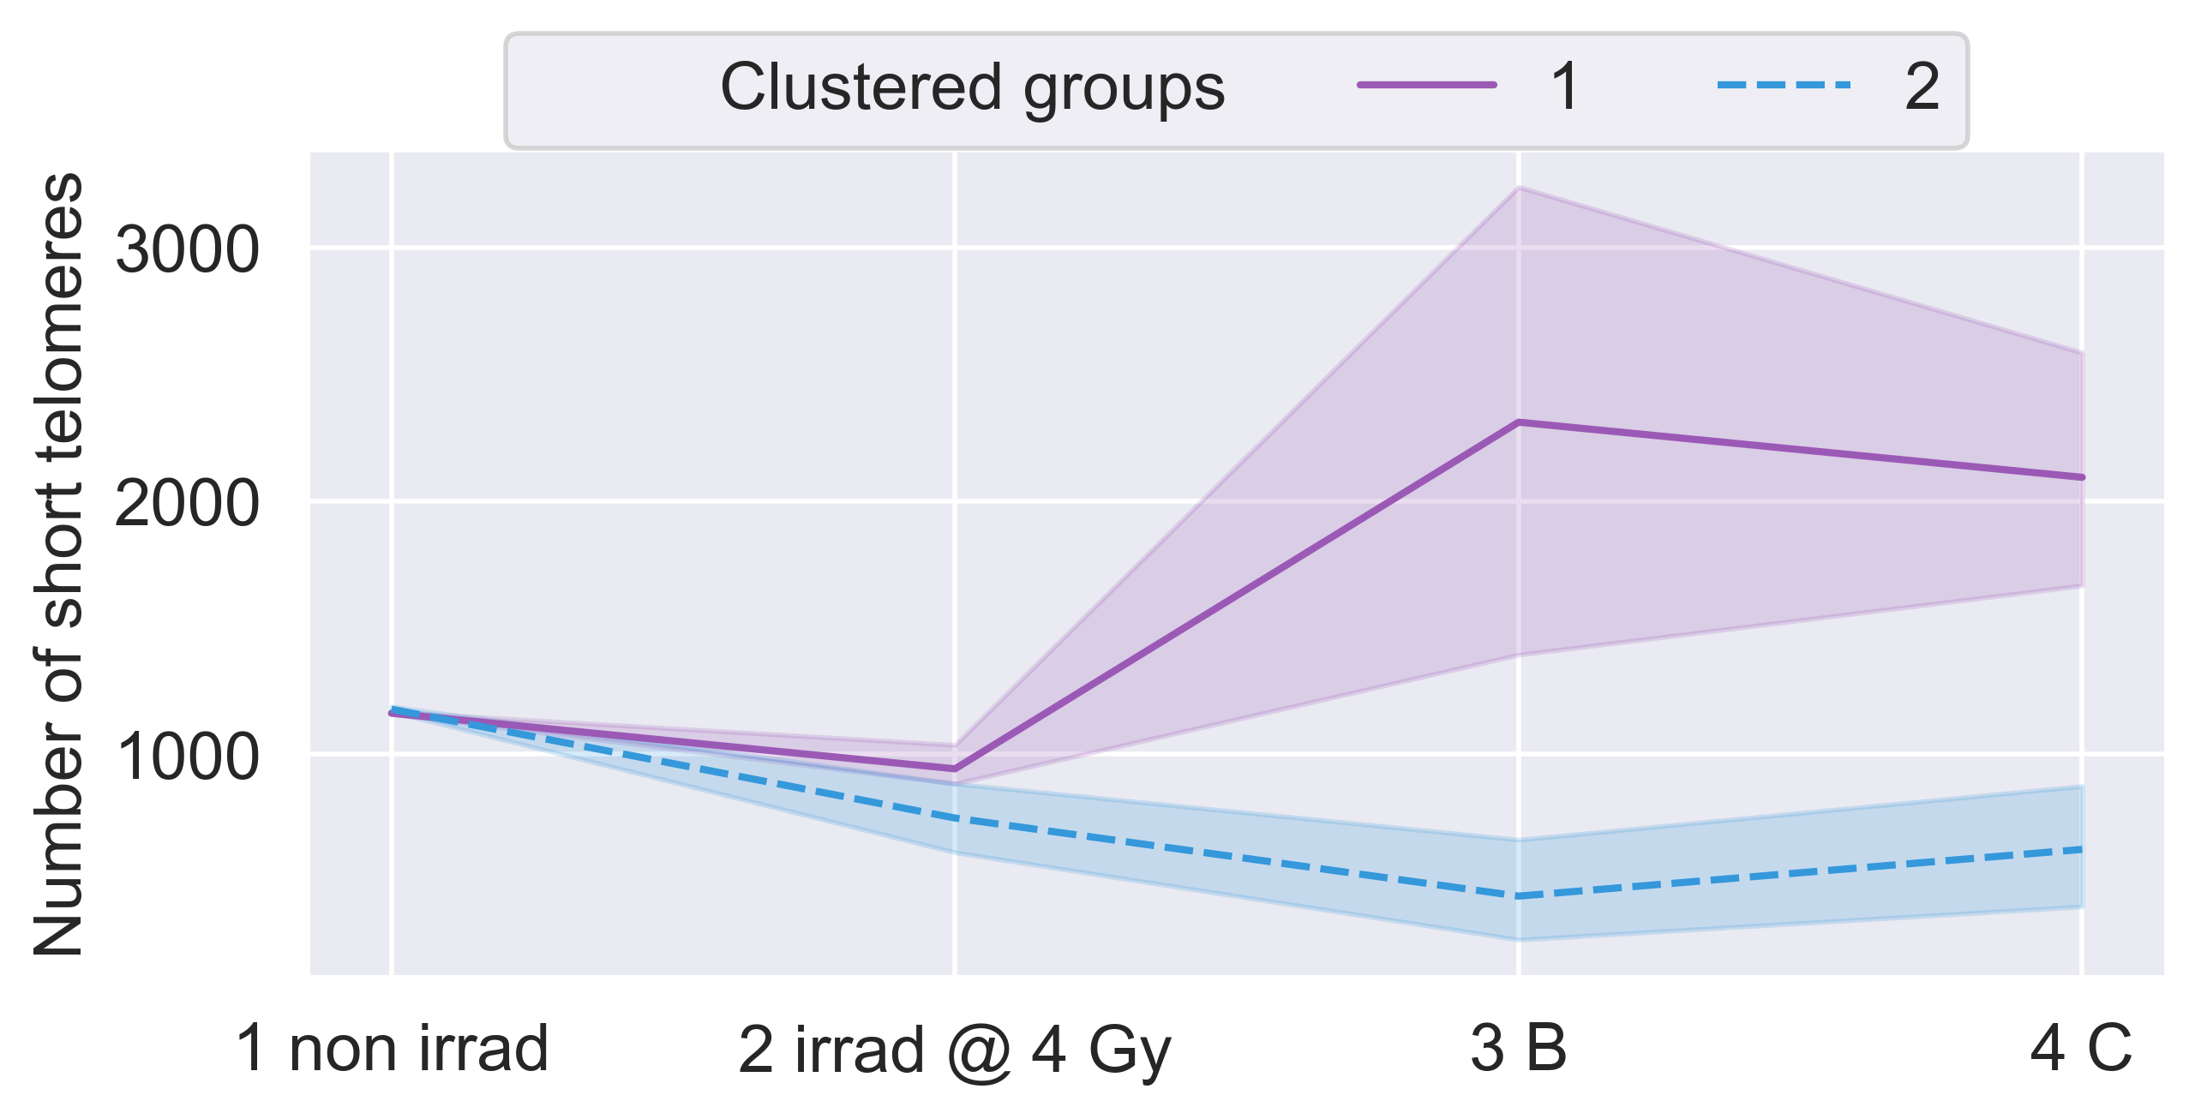
Clustering by numbers of short telomeres reveals
two sub-groups of patient responses
(identical patient compositions vs. mean telomere length groupings)
Notes:
Fig 3. Longitudinal trends in numbers of short and long telomeres (TeloFISH) during IMRT for patient cohort. Numbers of short and long telomeres feature engineered from individual telomere length distributions per patient. 1 non irrad: pre-therapy non-irradiated; 2 irrad @ 4 Gy: pre-therapy in vitro irradiated; 3 B: immediate post-therapy; 4 C: late post-therapy. Shortest (yellow), mid-length (blue), and longest (red) telomeres were feature engineered per patient (n=15) (see Materials and Methods). (A) Counts of short, medium, and long telomeres, 4600 individual telomeres per patient (n=15) per time point. Significance was assessed for counts of short and long telomere using a square-root transformation and a repeated measures ANOVA with post-hoc Tukey’s HSD test. Hierarchical clustering of patients by longitudinal changes in numbers of short telomeres (B) and long telomeres (D) (z-score normalized). Time-courses of patient groups (n=3 and n=11) clustered by numbers of short (C) and long (E) telomeres. Patient ID 13 not clustered; late post-therapy sample failed to culture. Center lines denote medians and lighter bands denote confidence intervals.

Slide 16
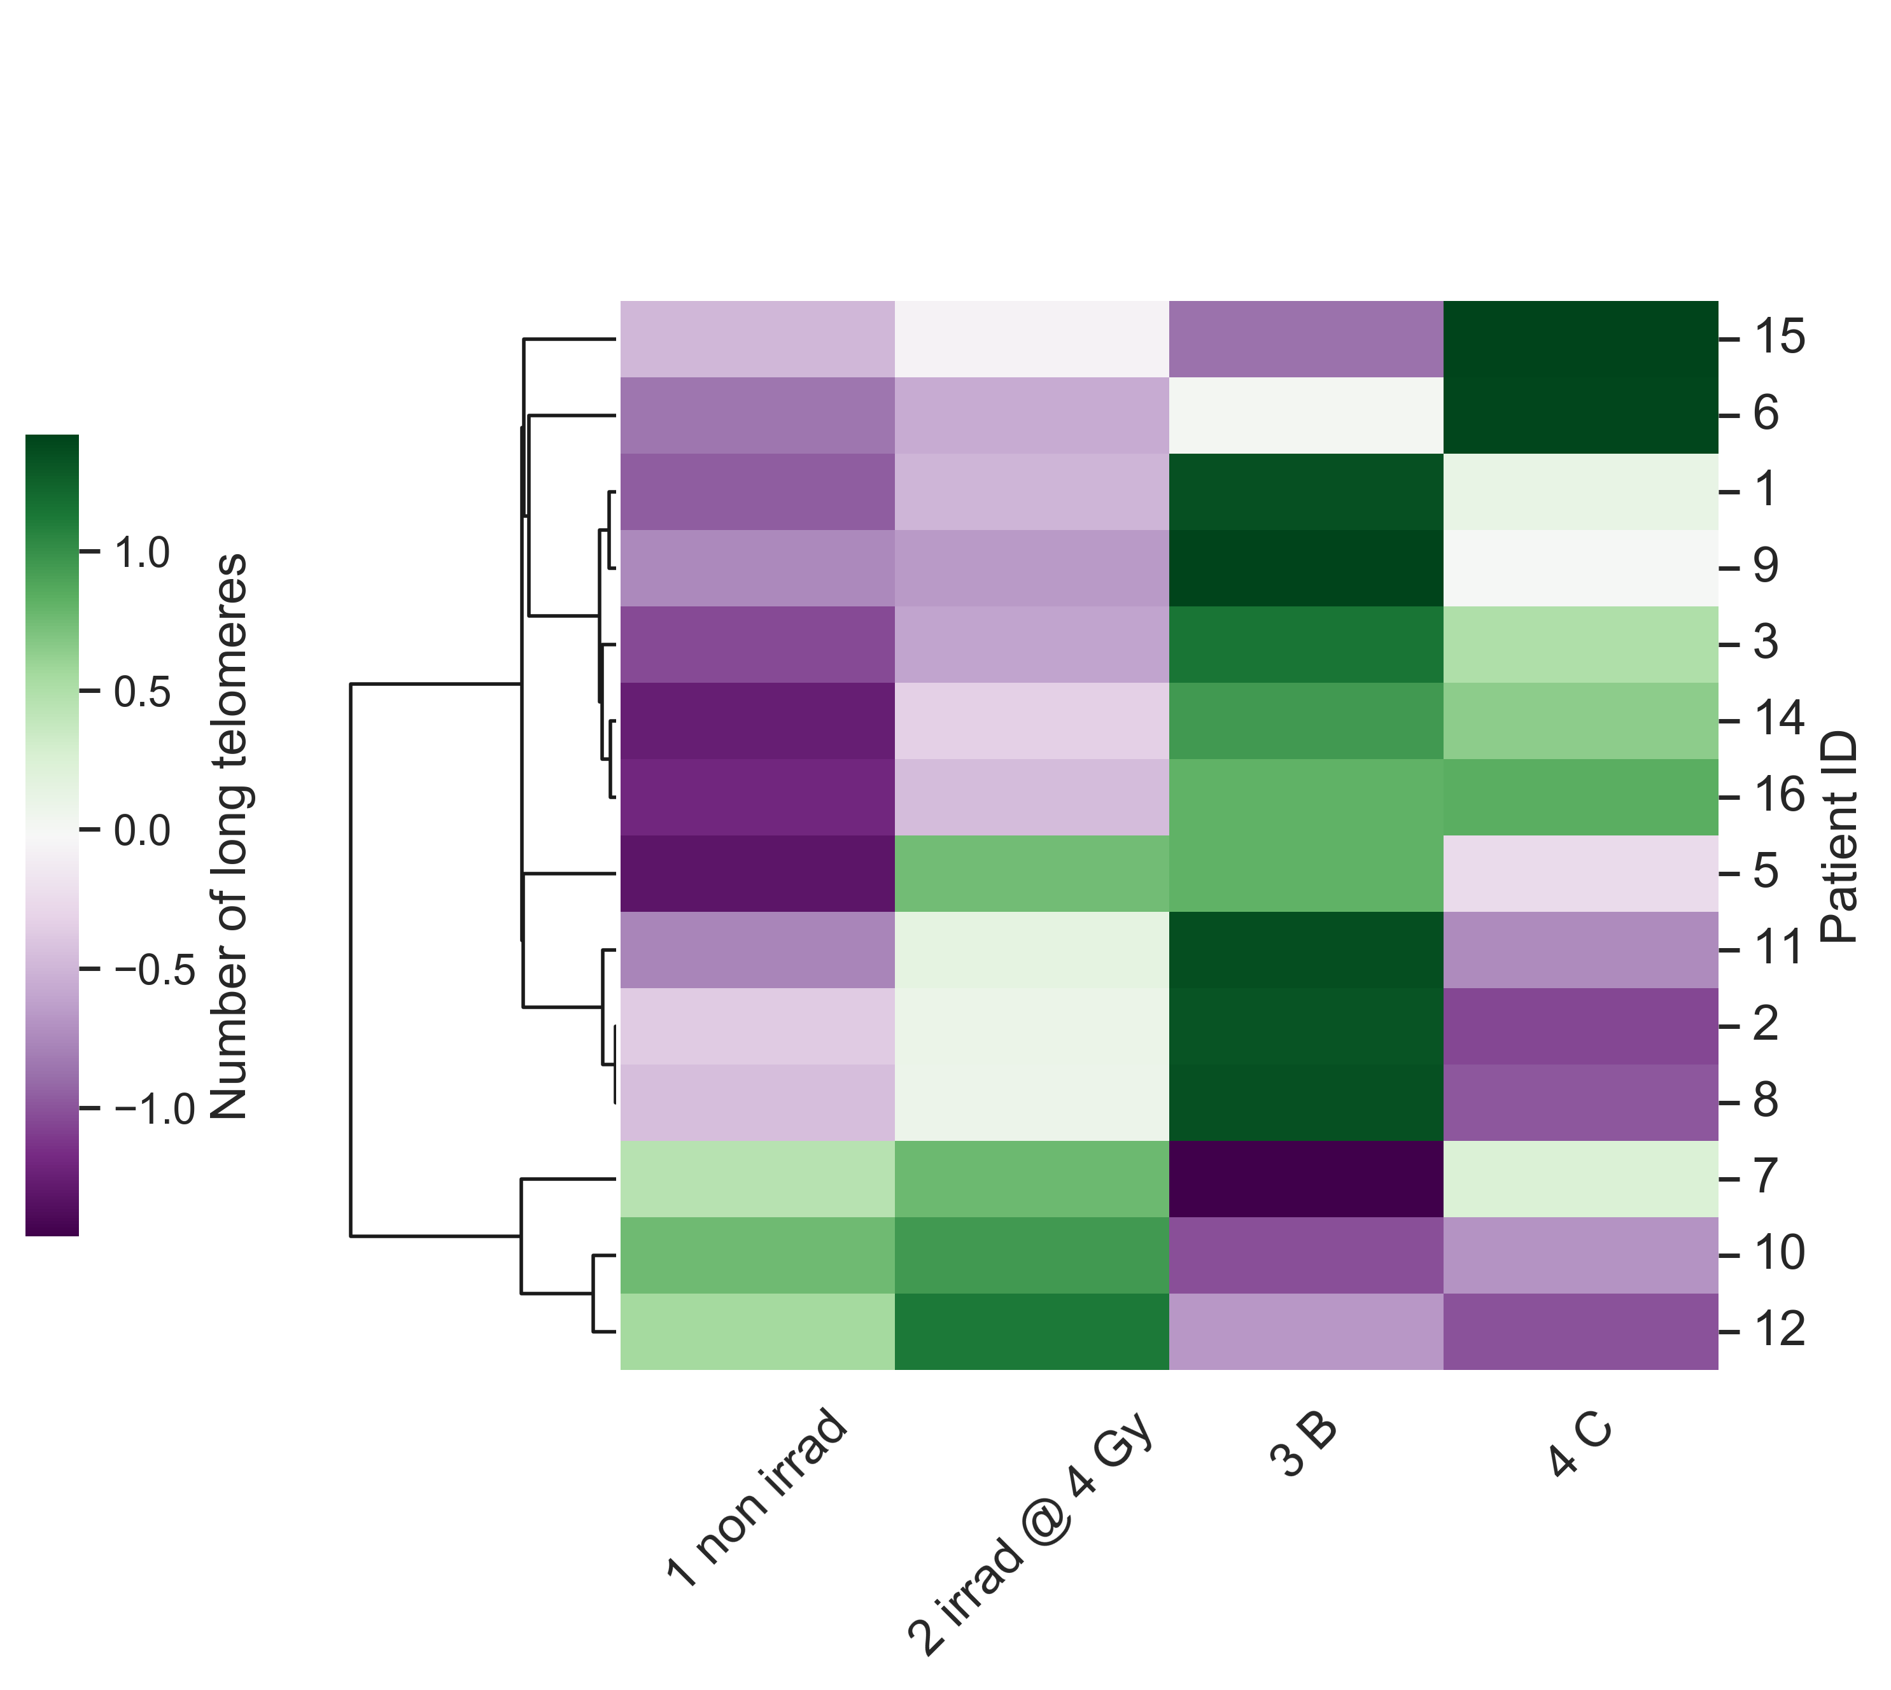
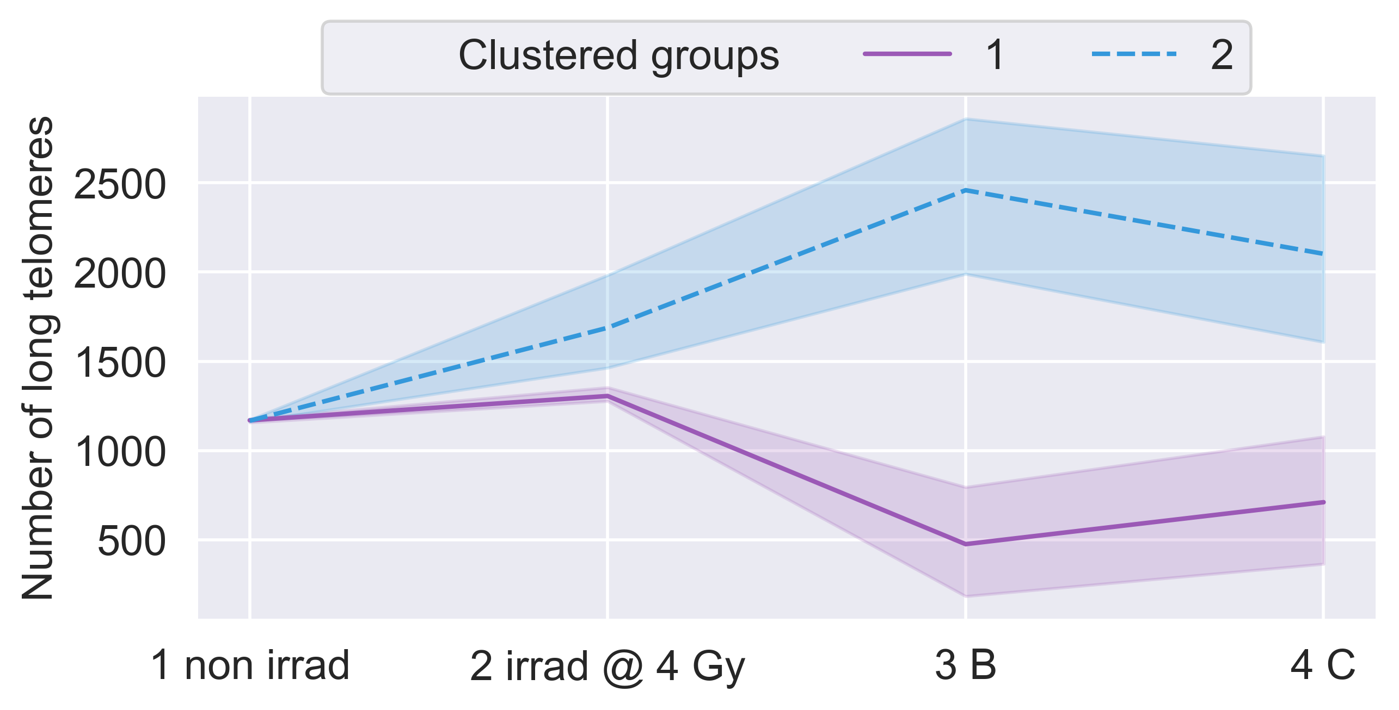
Clustering by numbers of long telomeres reveals
two sub-groups of patient responses
(identical patient compositions vs. mean telomere length groupings)
Notes:
Fig 3. Longitudinal trends in numbers of short and long telomeres (TeloFISH) during IMRT for patient cohort. Numbers of short and long telomeres feature engineered from individual telomere length distributions per patient. 1 non irrad: pre-therapy non-irradiated; 2 irrad @ 4 Gy: pre-therapy in vitro irradiated; 3 B: immediate post-therapy; 4 C: late post-therapy. Shortest (yellow), mid-length (blue), and longest (red) telomeres were feature engineered per patient (n=15) (see Materials and Methods). (A) Counts of short, medium, and long telomeres, 4600 individual telomeres per patient (n=15) per time point. Significance was assessed for counts of short and long telomere using a square-root transformation and a repeated measures ANOVA with post-hoc Tukey’s HSD test. Hierarchical clustering of patients by longitudinal changes in numbers of short telomeres (B) and long telomeres (D) (z-score normalized). Time-courses of patient groups (n=3 and n=11) clustered by numbers of short (C) and long (E) telomeres. Patient ID 13 not clustered; late post-therapy sample failed to culture. Center lines denote medians and lighter bands denote confidence intervals.

Slide 17
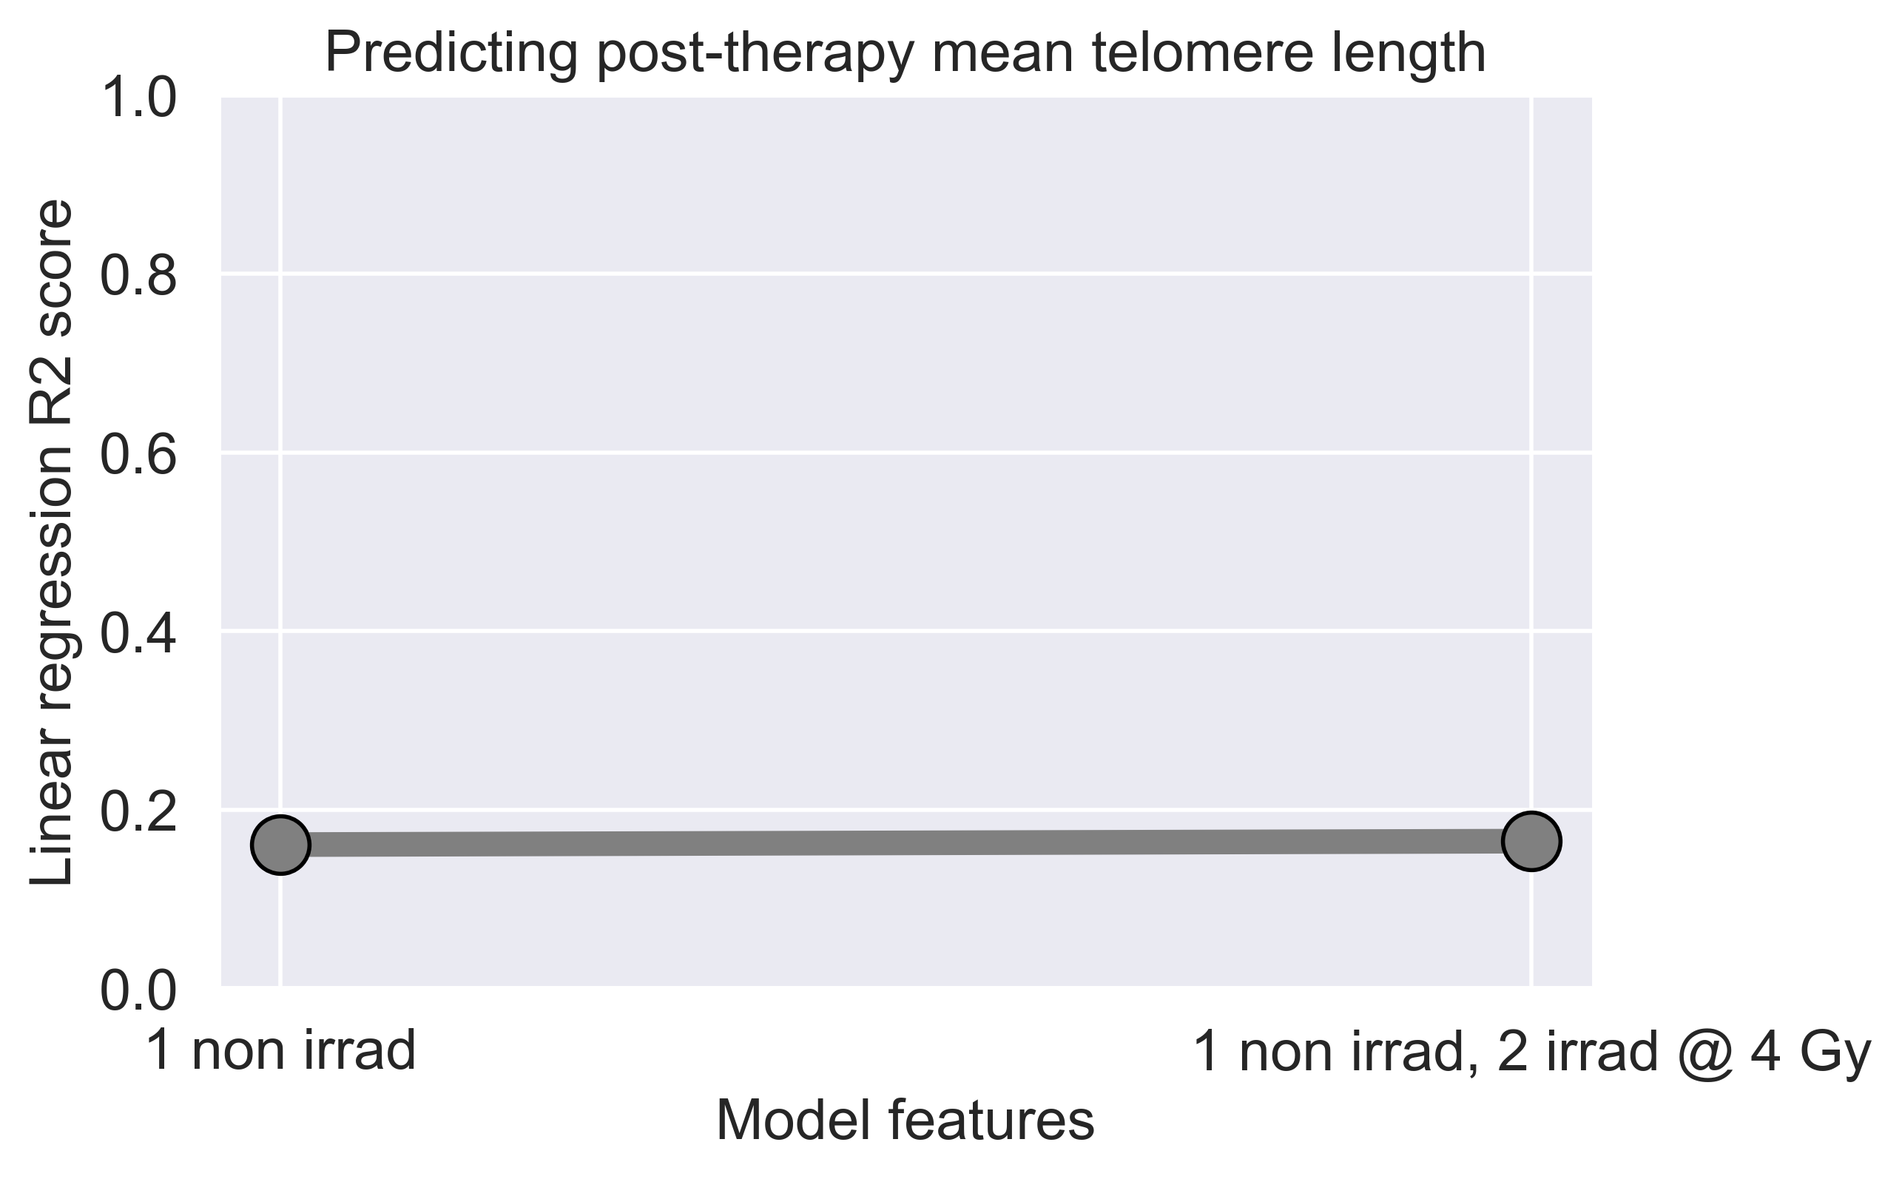
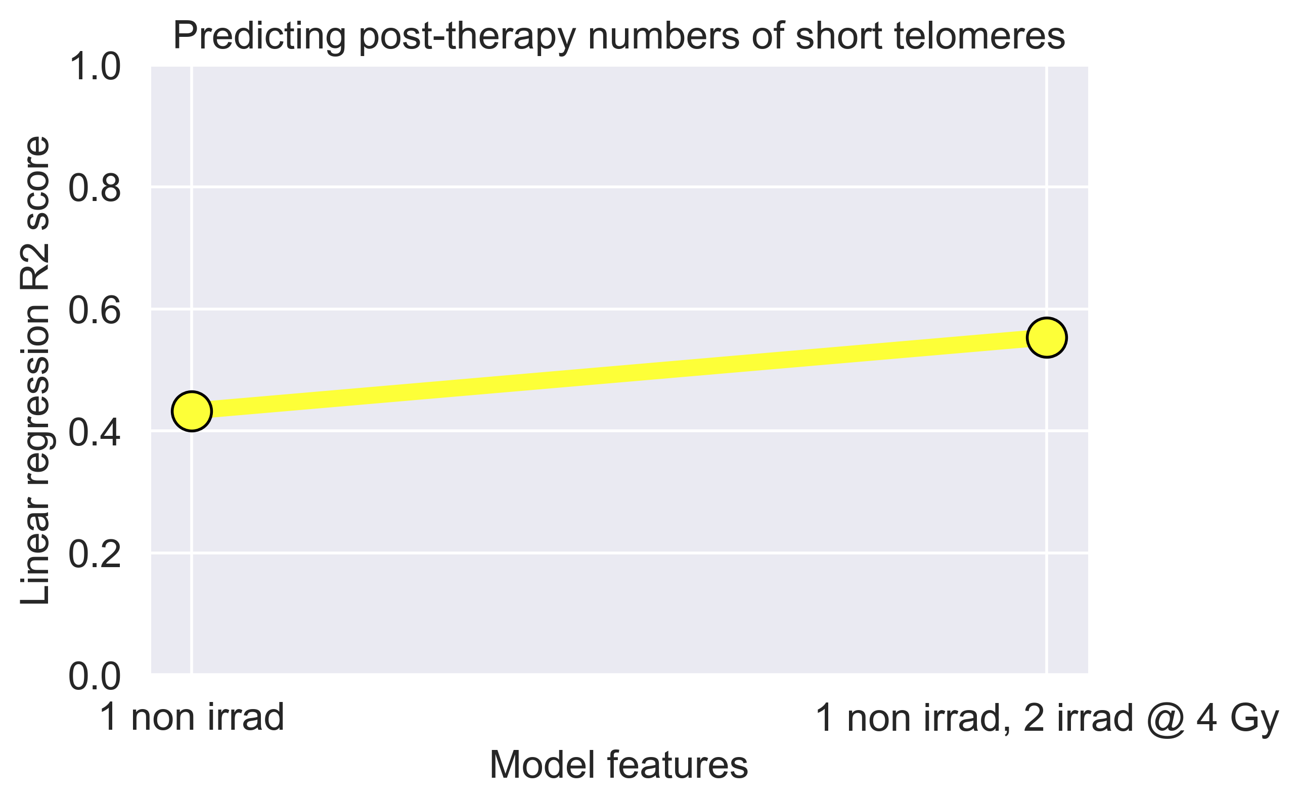
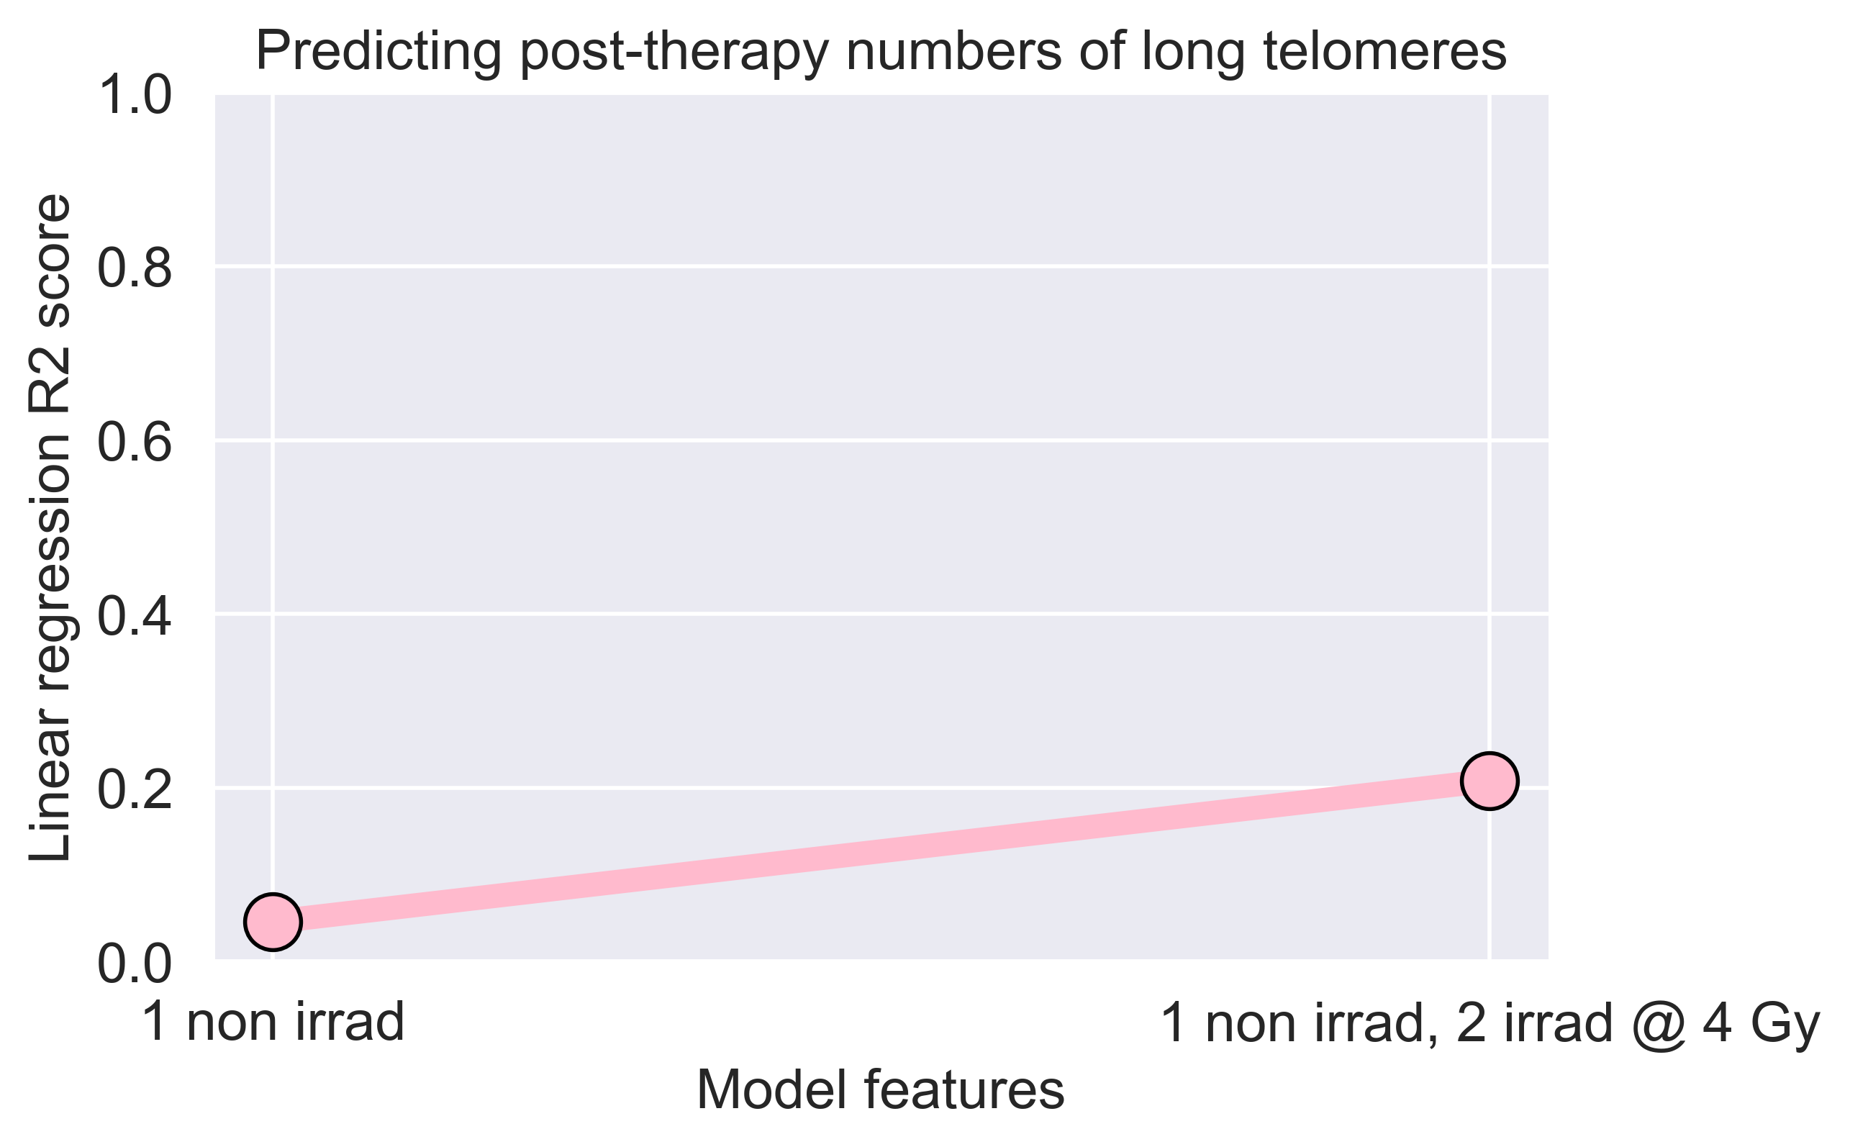
Linear regression failed to predict post-therapy (4 C) telomeric outcomes
1 non irrad
1 non irrad,
2 irrad @ 4 Gy
1 non irrad
1 non irrad,
2 irrad @ 4 Gy
1 non irrad
1 non irrad,
2 irrad @ 4 Gy
Model features
Model features
Model features
Notes:
Fig 4. Linear regression models failed to predict post-therapy telomeric outcomes. Ordinary Least Squares linear regression models were made using pre-therapy telomeric data from only the non-irradiated (1 non irrad) or also the in vitro irradiated (2 irrad @ 4 Gy) samples to predict post-therapy telomeric outcomes. R2 values indicate the amount of variance in post-therapy telomeric outcomes explained by the pre-therapy sample data. Models were made with pre-therapy mean telomere length (A) and numbers of short (B) and long (C) telomeres for predicting their respective post-therapy outcomes.

Slide 18
Linear regression failed to predict post-therapy (4 C) telomeric outcomes
Why:
low # observations (n=15 patients)?
nonlinear response pre- vs. post-therapy?
Need:
technique to leverage >100,000 pre-therapy individual telomere measurements
address nonlinearity
Solution? Machine learning
Notes:
Fig 4. Linear regression models failed to predict post-therapy telomeric outcomes. Ordinary Least Squares linear regression models were made using pre-therapy telomeric data from only the non-irradiated (1 non irrad) or also the in vitro irradiated (2 irrad @ 4 Gy) samples to predict post-therapy telomeric outcomes. R2 values indicate the amount of variance in post-therapy telomeric outcomes explained by the pre-therapy sample data. Models were made with pre-therapy mean telomere length (A) and numbers of short (B) and long (C) telomeres for predicting their respective post-therapy outcomes.

Slide 19
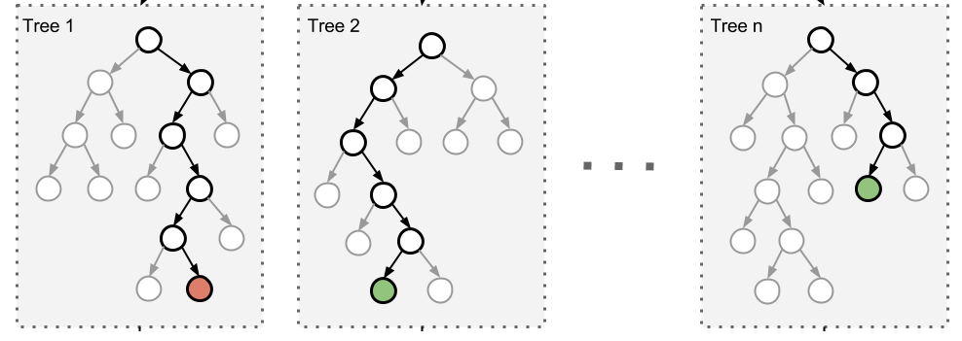
eXtreme Gradient Boosting: XGBoost machine learning models
model 1
training, learns from errors
XGBoost: an ensemble of gradient boosted trees
highly efficacious, flexible (regression & classification)
google scholar ‘xgboost cancer’: >1000 entries since 2019
accessible (runs on laptop)
model 1
model 2
model n
Notes:
Fig 6. High performance of XGBoost models for predicting post-therapy telomeric outcomes in the test set. XGBoost models were trained on pre-therapy individual telomere length measurements to predict post-therapy telomeric outcomes. Trained XGBoost models were challenged with the test set (new data) to predict post-therapy telomeric outcomes. XGBoost predictions were averaged on a per patient basis for mean telomere length (A) and numbers of short (B) and long (C) telomeres. R2 values between averaged predictions and actual values were 0.931 (A), 0.877 (B), and 0.890 (C). Patient IDs not labeled.

Slide 20
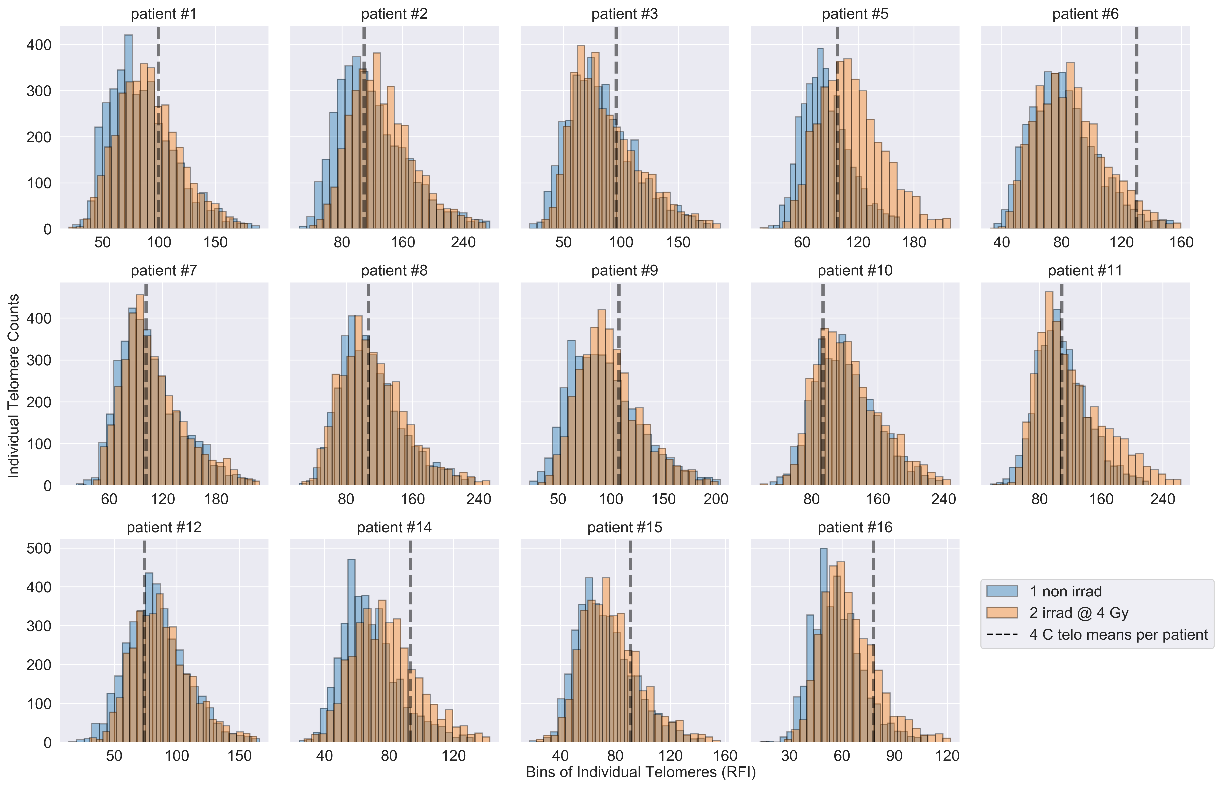
Telomeres and XGBoost for prediction of post-therapy telomeric outcomes
Notes:
Fig 6. High performance of XGBoost models for predicting post-therapy telomeric outcomes in the test set. XGBoost models were trained on pre-therapy individual telomere length measurements to predict post-therapy telomeric outcomes. Trained XGBoost models were challenged with the test set (new data) to predict post-therapy telomeric outcomes. XGBoost predictions were averaged on a per patient basis for mean telomere length (A) and numbers of short (B) and long (C) telomeres. R2 values between averaged predictions and actual values were 0.931 (A), 0.877 (B), and 0.890 (C). Patient IDs not labeled.

Slide 21
Processing individual telomere length data for XGBoost models
Preprocessed data
Train (80%) test (20%) split
Cleaned train/test data
Patient IDs
shuffle
Train data
strip IDs
Features 1, 2
Features 1, 2
Target
Optimization
Target
stratify
Test data
encode labels
Cross validation
XGBoost models
Hyperparameter search
Model evaluation
Testing model
Training model
Test data
Trained XGBoost models
Train data
Predicted telomeric outcomes
Target: Actual
telomeric outcomes
Notes:
Fig 5. Processing of TeloFISH data for training and testing XGBoost models. Schematic for our machine learning pipeline with TeloFISH data. Preprocessed data: Feature 1: Pre-therapy individual telomere lengths measurements; Feature 2: Pre-therapy sample labels (non-irradiated, in vitro irradiated, encoded as 0/1); Target: Late post-therapy telomeric outcomes (mean telomere length or numbers of short and long telomeres. Data is randomly shuffled and stratified by patient ID and pre-therapy sample origin; patient ID is stripped after shuffling. Five-fold cross validation was used, and models were evaluated with Mean Absolute Error (MAE) and R2 scores between predicted and true values in the test set. See Materials and Methods and Code availability for model parameters and our implementations in Python.

Slide 22
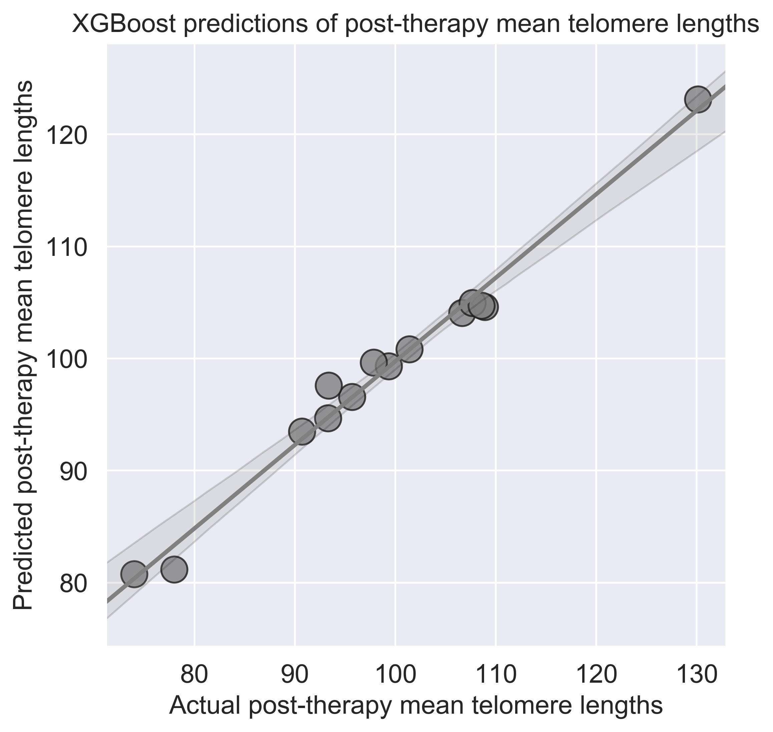
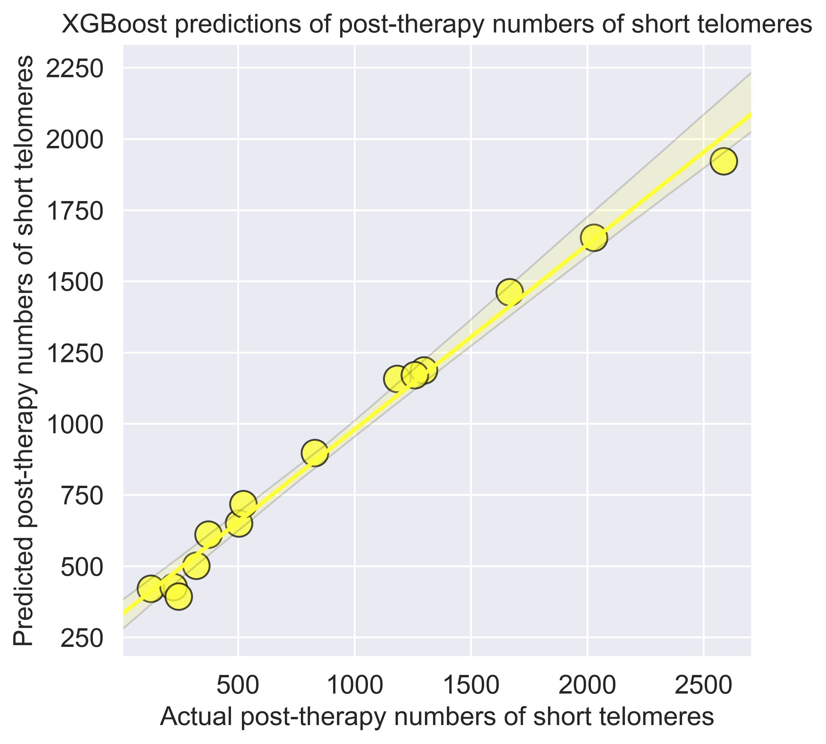
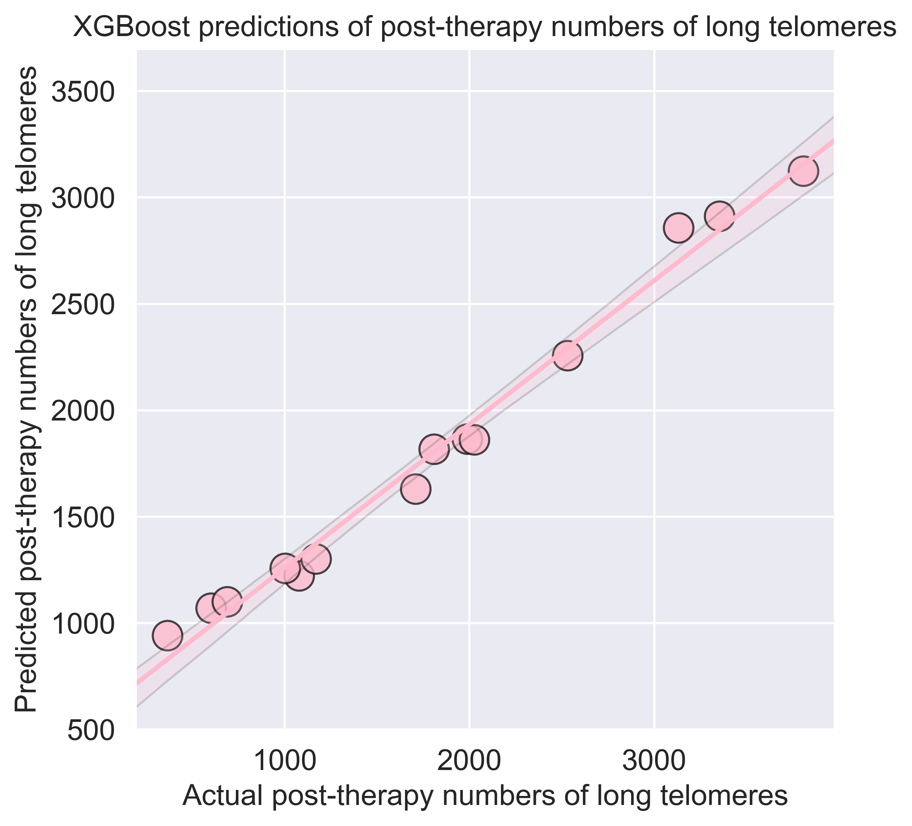
Highly accurate predictions of patients’ post-therapy telomeric outcomes (4 C)
by XGBoost with pre-therapy telomere data from test set (new data)
R2 = 0.931
R2 = 0.877
R2 = 0.890
Notes:
Fig 6. High performance of XGBoost models for predicting post-therapy telomeric outcomes in the test set. XGBoost models were trained on pre-therapy individual telomere length measurements to predict post-therapy telomeric outcomes. Trained XGBoost models were challenged with the test set (new data) to predict post-therapy telomeric outcomes. XGBoost predictions were averaged on a per patient basis for mean telomere length (A) and numbers of short (B) and long (C) telomeres. R2 values between averaged predictions and actual values were 0.931 (A), 0.877 (B), and 0.890 (C). Patient IDs not labeled.

Slide 23
Conclusions
telomeric response to radiation therapy is dynamic, varied
changes in telomere length post-radiation therapy can be accurately predicted w/ pre-therapy individual telomere length data & XGBoost
strong proof-of-concept, functional support for trialing telomere length as a biomarker for radiation late effects in larger cohort
Notes:
Fig 6. High performance of XGBoost models for predicting post-therapy telomeric outcomes in the test set. XGBoost models were trained on pre-therapy individual telomere length measurements to predict post-therapy telomeric outcomes. Trained XGBoost models were challenged with the test set (new data) to predict post-therapy telomeric outcomes. XGBoost predictions were averaged on a per patient basis for mean telomere length (A) and numbers of short (B) and long (C) telomeres. R2 values between averaged predictions and actual values were 0.931 (A), 0.877 (B), and 0.890 (C). Patient IDs not labeled.

Slide 24
Future directions/studies:
… should relate magnitude of change in post-therapy telomeric outcomes with type/time to onset/severity of late effects
… should ensemble telomere data w/ other types; value add?
sequencing; explore functional basis of variation in telomeric response to radiation
larger patient cohorts w/ broader demographics
XGBoost vs. deep learning/other frameworks
TeloFISH vs. flowFISH, others
astronauts?
Notes:
Fig 6. High performance of XGBoost models for predicting post-therapy telomeric outcomes in the test set. XGBoost models were trained on pre-therapy individual telomere length measurements to predict post-therapy telomeric outcomes. Trained XGBoost models were challenged with the test set (new data) to predict post-therapy telomeric outcomes. XGBoost predictions were averaged on a per patient basis for mean telomere length (A) and numbers of short (B) and long (C) telomeres. R2 values between averaged predictions and actual values were 0.931 (A), 0.877 (B), and 0.890 (C). Patient IDs not labeled.

Slide 25


Acknowledgements
PI: Susan Bailey
PhD committee members: Lucas Argueso, Takamitsu Kato, Jennifer DeLuca
Lynn Taylor, Miles McKenna
David Maranon (endless microscopy advice)
KromaTiD (dGH probes)
Computational training support (Python) from CSU’s GAUSSI program and qCMB T32 grant (NIH), and support from the Cancer Biology & Comparative Oncology PRSE (CSU) program are all gratefully acknowledged.
Notes:
Future directions .. Stem cells ,

